Slide 1


WSQ COURSE · TGS-2024043855
Version v8 · 9 November 2026
Creating Engaging Videos with Generative AI (GenAI)
Made entirely in Higgsfield: Supercomputer · Cinema Studio · Seedance 2.5 · Elements · Draft mode
Tertiary Infotech Academy Pte Ltd
UEN 201200696W
www.tertiarycourses.com.sg | enquiry@tertiaryinfotech.com | +65 6100 0613

Slide 2
COURSE ADMINISTRATION
Welcome & Housekeeping
© Tertiary Infotech Academy Pte Ltd
Creating Engaging Videos with Generative AI (GenAI) · TGS-2024043855
2

Slide 3
TRAQOM · SSG DIGITAL ATTENDANCE
Digital Attendance (Mandatory)
It is mandatory to take the AM, PM and Assessment digital attendance for WSQ-funded courses.
The trainer/administrator displays the digital attendance QR code from the SSG portal.
1
2
Scan the QR code with your mobile phone camera and submit your attendance.
A minimum of 75% attendance is required to be eligible for assessment and funding.
3
4
© Tertiary Infotech Academy Pte Ltd
Creating Engaging Videos with Generative AI (GenAI) · TGS-2024043855
3

Slide 4
YOUR TRAINER · GENERAL
About the Trainer
NAME
____________________________________________
?
TITLE / DESIGNATION
____________________________________________
QUALIFICATIONS
____________________________________________
Your Trainer
AREAS OF EXPERTISE
____________________________________________
General Trainer template —
to be completed by the trainer
TRAINING & INDUSTRY EXPERIENCE
____________________________________________
CONTACT
____________________________________________
© Tertiary Infotech Academy Pte Ltd
Creating Engaging Videos with Generative AI (GenAI) · TGS-2024043855
4

Slide 5
YOUR TRAINER
About the Trainer
CURRENT ROLES
Producer at Asia Media Alliance (2024–present); Director at Asia Media Academy (2020–present).
TH
FILM & TV TRACK RECORD
Team Lead, Camokakis Content (Digital) and Senior Commissioning Editor at So Drama! Entertainment; Executive Producer at Stardust Pictures; VP Physical Productions at Infinite Frameworks Studios.
Mr Tay Hoo Wee
QUALIFICATIONS
BA (Hons) Digital Film Making, Middlesex University; Diploma in Digital Film Production, SAE Institute Singapore.
Producer, Asia Media Alliance
Director, Asia Media Academy
CONTACT
linkedin.com/in/hoowee
© Tertiary Infotech Academy Pte Ltd
Creating Engaging Videos with Generative AI (GenAI) · TGS-2024043855
5

Slide 6
ICE-BREAKER
Let's Know Each Other
Your name and organisation / role.
Your experience with video creation or editing (if any).
1
2
What videos do you want to create after this course — marketing, training, social media?
3
© Tertiary Infotech Academy Pte Ltd
Creating Engaging Videos with Generative AI (GenAI) · TGS-2024043855
6

Slide 7
HOUSEKEEPING
Ground Rules
Set your mobile phone to silent mode.
Participate actively — no question is too small.
1
2
Respect each other's views.
One conversation at a time.
3
4
Exit quietly for calls or breaks.
Be punctual; 75% attendance is required.
5
6
© Tertiary Infotech Academy Pte Ltd
Creating Engaging Videos with Generative AI (GenAI) · TGS-2024043855
7

Slide 8
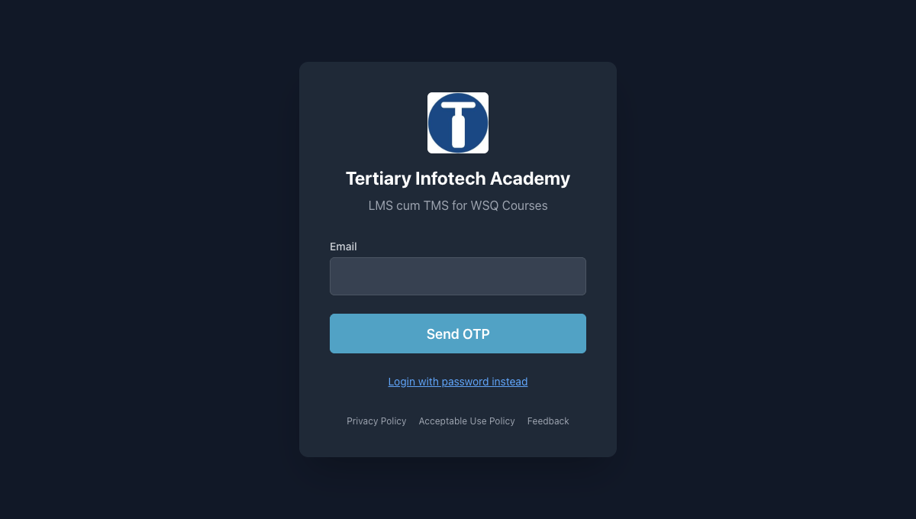
LMS / TMS COURSE PORTAL
Download Course Material
Go to lms-tms.tertiaryinfotech.com and sign in with your registered email.
1
Open My Courses and select this course.
2
Download the Trainer Slides, Learner Guide and Lesson Plan PDFs.
3
Keep them handy — the final assessment is open book.
4
https://lms-tms.tertiaryinfotech.com
© Tertiary Infotech Academy Pte Ltd
Creating Engaging Videos with Generative AI (GenAI) · TGS-2024043855
8

Slide 9
SCHEDULE · LU1 4 H · LU2 5 H · LU3 5 H
Lesson Plan — 2 Days, 8 hours/day
Day 1
Day 2
• Day 1 — Script, Plan, Build Elements, Direct the First Takes
– 9:30 · LU1 — attendance, introductions, Higgsfield sign-up
– LU1 (to 14:30): impact & use cases, Labs 1–3
– LU2 (14:30): Elements — Lab 4; Cinema Studio — Lab 5
– PM attendance 14:00 · Day 1 recap 18:15
• Day 2 — Cut, Fix, Finish, Publish & Assessment
– 9:30 · attendance · LU2: cut & assess — Lab 6
– LU3 (10:30): fix, voice, music, effects — Labs 7–8
– LU3: use-case sprint — Lab 9 · course summary
– 16:15 TRAQOM · briefing · assessment attendance
– 16:30 WA (1 h) · 17:30 PP (1 h)
© Tertiary Infotech Academy Pte Ltd
Creating Engaging Videos with Generative AI (GenAI) · TGS-2024043855
9

Slide 10
WSQ · SKILLS FRAMEWORK
Skills Framework
Knowledge (assessed in the WA)
Abilities (assessed in the PP)
• TSC: Video Editing · MED-MPN-4005-1.1
– K1: Types of quality issues in video content
– K2: Types of solutions to rectify quality issues
– K3: Parameters to assess video quality
– K4: Industry quality standards
– K5: Technologies that improve efficiency and quality of video edits
• Abilities
– A1: Review scripts to conceptualize the types of edits required to achieve creative vision of production
– A2: Develop editing standards and guidelines in accordance to legal requirements and broadcasting standards
– A3: Develop work plans to outline the processes and timelines needed for the post production processes
– A4: Review edited footage to propose changes that will enhance the story and emotions in each scene
– Plus A5–A7 (assessed in the PP)
© Tertiary Infotech Academy Pte Ltd
Creating Engaging Videos with Generative AI (GenAI) · TGS-2024043855
10

Slide 11
WHAT YOU'LL ACHIEVE
Learning Outcomes
LO1 — Script & plan
Create video scripts using Generative AI (GAI) and work plans for video production.
1
LO2 — Edit & assess
Edit video footage to improve video quality and ensure technical compliance.
2
LO3 — Apply new AI
Apply new AI technologies to improve efficiency and quality in accordance to industry standards.
3
© Tertiary Infotech Academy Pte Ltd
Creating Engaging Videos with Generative AI (GenAI) · TGS-2024043855
11

Slide 12
THREE TOPICS · NINE HANDS-ON LABS · ONE STUDIO: HIGGSFIELD
Course Outline
Topic 1 — Script, Plan and Make Your First Video
Higgsfield sign-up, Supercomputer and AI Director scripts and shot lists, standards, work plan and credit budget. (Labs 1–3)
1
Topic 2 — Build, Shoot and Assess
Elements (characters, locations, props), references, Cinema Studio shots and takes, Draft mode, cut, captions and quality scoring. (Labs 4–6)
2
Topic 3 — Fix, Finish and Publish
Replace objects, upscale, reframe, voice, music, cinematic effects, model comparison and a published 15 s ad. (Labs 7–9)
3
© Tertiary Infotech Academy Pte Ltd
Creating Engaging Videos with Generative AI (GenAI) · TGS-2024043855
12

Slide 13
ASSESSMENT RULES
Briefing for Assessment
Place phones and other materials under the table or on the floor.
No photos or recording of assessment scripts.
1
2
No discussion during the assessment.
Use a black/blue pen for hard-copy assessments.
3
4
No liquid paper / correction tape.
Scripts are collected when time is up.
5
6
© Tertiary Infotech Academy Pte Ltd
Creating Engaging Videos with Generative AI (GenAI) · TGS-2024043855
13

Slide 14
FINAL ASSESSMENT
Assessment
Written Assessment (WA) — Short-Answer Questions (SAQ), 1 hour, open book.
Practical Performance (PP) — three Higgsfield production tasks, 1 hour, open book; paste screenshots under each task and upload your final video to the TMS.
1
2
Format: Open Book — slides, Learner Guide and approved materials only.
A minimum of 75% attendance is required to be eligible for assessment and funding.
3
4
An appeal process is available if required.
5
© Tertiary Infotech Academy Pte Ltd
Creating Engaging Videos with Generative AI (GenAI) · TGS-2024043855
14

Slide 15
ON ASSESSMENT DAY
Assessment Flow
1
2
3
4
5
TRAQOM survey — scan the QR code on the LMS
Assessment digital attendance — scan the SSG QR
Sit WA (SAQ) then PP — open book
Submit your answers on the LMS
Sign the Assessment Summary Record
© Tertiary Infotech Academy Pte Ltd
Creating Engaging Videos with Generative AI (GenAI) · TGS-2024043855
15

Slide 16
WSQ FUNDING
Criteria for Funding
75% attendance
Minimum attendance rate of 75% based on the SSG Digital Attendance record.
1
Assessed Competent
Complete the assessment and be assessed as 'Competent'.
2
© Tertiary Infotech Academy Pte Ltd
Creating Engaging Videos with Generative AI (GenAI) · TGS-2024043855
16

Slide 17
THE BIG PICTURE
One Studio Makes the Whole Video
Script, cast, shoot, fix and publish without leaving Higgsfield
© Tertiary Infotech Academy Pte Ltd
Creating Engaging Videos with Generative AI (GenAI) · TGS-2024043855
17

Slide 18
WHY THIS COURSE
Two 15-second films. Two prompts. Zero cameras.
Both clips on the next slides were made for this course in Higgsfield with Seedance 2.5, one prompt each, sound included. By the end of Day 2 you will direct your own.
© Tertiary Infotech Academy Pte Ltd
Creating Engaging Videos with Generative AI (GenAI) · TGS-2024043855
18

Slide 19

MADE IN HIGGSFIELD · AI MARKETING
SOLA: a 15-second product ad
A product ad with a hero packshot, written as five timed shots
THE SHOTS WE PROMPTED
0–3 s
extreme close-up, sun slides across the bottle
3–6 s
runner grabs it mid-stride (tracking)
6–9 s
drink, ice clinks (slow motion)
9–12 s
wide rooftop run, drone pulls back
12–15 s
hero packshot with space for the logo
▶ Click to play · Seedance 2.5 · 1080p · 16:9 · 15 s · native audio · 240 credits
© Tertiary Infotech Academy Pte Ltd
Creating Engaging Videos with Generative AI (GenAI) · TGS-2024043855
19
Notes:
Play it with sound. Point out: the bottle stays the same in every shot because the prompt names it in every shot; the beat hits on the packshot because the Sound line asked for it. Cost: 240 credits at 1080p; the same take as a 480p Draft costs 45.

Slide 20

MADE IN HIGGSFIELD · AI SCI-FI
Ringfall: a 15-second epic sci-fi scene
An epic scene with an establishing shot, a reveal and a payoff
THE SHOTS WE PROMPTED
0–4 s
wide: smoking starship wreck, twin suns
4–8 s
pilot steps out, handheld follow
8–11 s
close-up: awe, ground trembles
11–15 s
extreme wide: the ring rises, crane up
▶ Click to play · Seedance 2.5 · 1080p · 16:9 · 15 s · native audio · 240 credits
© Tertiary Infotech Academy Pte Ltd
Creating Engaging Videos with Generative AI (GenAI) · TGS-2024043855
20
Notes:
Ask learners which shot sells the scale (the extreme wide at 11–15 s) and why the close-up comes before it (we see her awe before we see what she sees).

Slide 21
THE PROCESS YOU'LL RUN — EVERY LAB MAPS TO A STAGE
The Higgsfield Video Pipeline
1
2
3
4
5
Script & Shot List
Elements
Shots & Takes
Fix & Finish
Publish
Supercomputer · AI Director
characters · locations · props
Cinema Studio · Seedance 2.5
replace · upscale · voice · music
9:16 + 16:9 · TikTok · YouTube
ONE PLATFORM, FIVE STAGES
You script and plan in Supercomputer (Topic 1), build Elements and direct takes in Cinema Studio (Topic 2), then fix, finish and publish (Topic 3).
© Tertiary Infotech Academy Pte Ltd
Creating Engaging Videos with Generative AI (GenAI) · TGS-2024043855
21

Slide 22
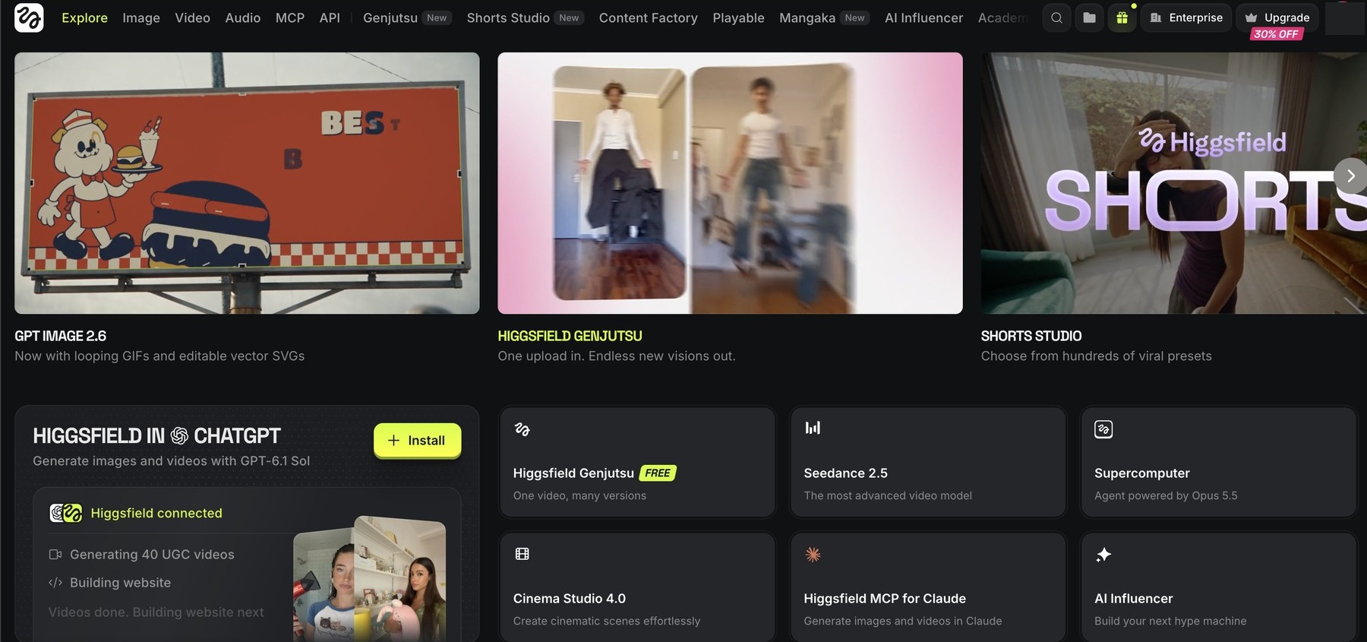
HIGGSFIELD.AI · THE HOME PAGE
Every tool you need sits on one home page
Learn five tiles today and you can find everything else from them
4
2
1
3
5
1
Supercomputer
2
Seedance 2.5
3
Cinema Studio 4.0
4
Genjutsu
5
Higgsfield in Claude & ChatGPT
The agent: brief it in plain English, it plans, prompts and asks before it spends.
ByteDance's video model: 4–30 s, up to 1080p, native sound, 50 references.
The director's chair: camera, lens, light, colour, genre.
One upload, many versions: swap objects, copy motion.
The same studio through an MCP connector.
© Tertiary Infotech Academy Pte Ltd
Creating Engaging Videos with Generative AI (GenAI) · TGS-2024043855
22
Notes:
Live demo: open higgsfield.ai, hover each tile. The top nav (Image, Video, Audio, Genjutsu, Shorts Studio, AI Influencer) holds the single-purpose tools; Supercomputer can call all of them.

Slide 23

SIGN-UP · BEFORE YOU START
Sign up with the course link
One link, one account: everything in this course happens inside it
SIGN UP
Open higgsfield.ai?fpr=alfred-d0d32b and create your account with Google or email.
DISCLOSURE
Trainer's affiliate link: the trainer may earn a commission; you pay the normal price.
PLAN FOR THE LABS
Labs run on the website, which needs a paid plan. Plus: US$49/month or US$39 billed yearly for 1,000 credits (8 Nov 2026).
Scan to sign up
higgsfield.ai?fpr=alfred-d0d32b
FREE TRIAL TERMS
3 days, needs a card, renews to Plus unless cancelled within 3 days; trial credits worked only through the Higgsfield MCP, not the website (8 Nov 2026).
© Tertiary Infotech Academy Pte Ltd
Creating Engaging Videos with Generative AI (GenAI) · TGS-2024043855
23
Notes:
Check every learner can see a credit balance before Lab 1. If the class uses trainer-provided accounts, hand them out here and skip sign-up.

Slide 24
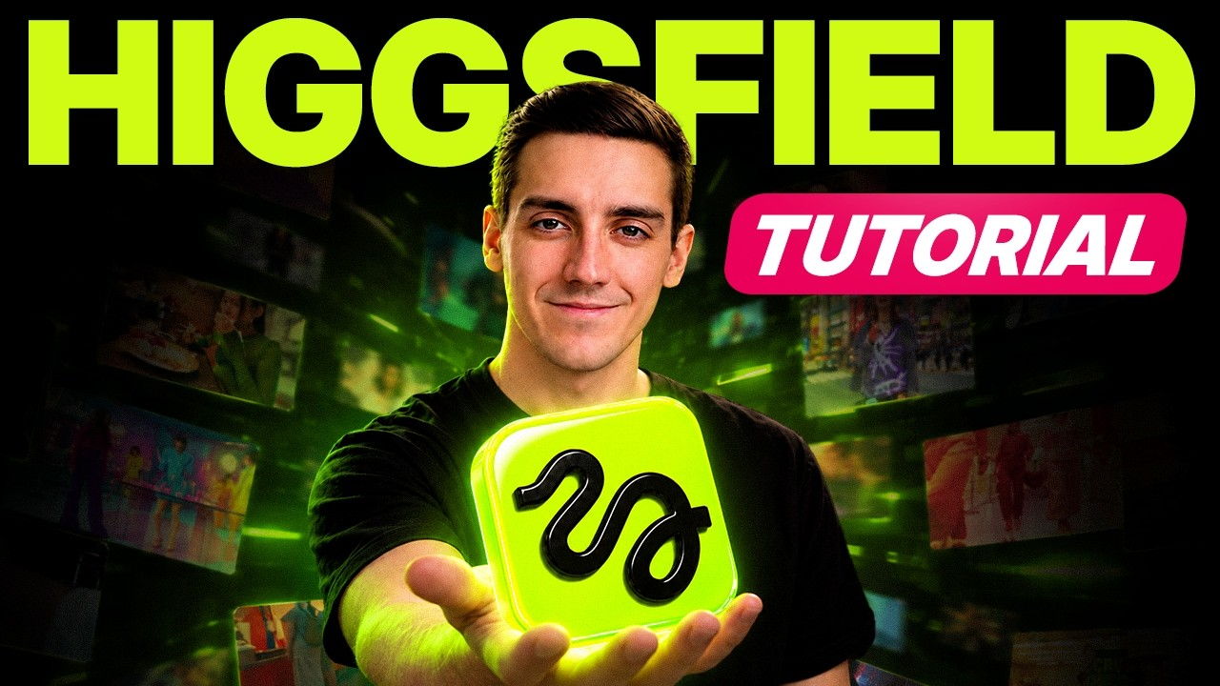
HIGGSFIELD · REFERENCES
Learn the studio in one sitting
Two sources to keep open beside the labs: the beginner tutorial and the official docs
Higgsfield API docs
For automation: authentication, requests, polling, webhooks and model-specific endpoints.
https://docs.higgsfield.ai/docs
Supercomputer
The agent, its Skills Marketplace and skill import from Claude, Claude Code, Codex and ChatGPT.
https://higgsfield.ai/supercomputer-intro
Course labs
Prompt pages with one-click copy, instruction PDFs and mock assets for Labs 1–9.
labs/index.html in the course repo
▶ Open in YouTube
WATCH BEFORE LAB 1 · METICS MEDIA
Higgsfield AI Tutorial for Beginners (2026) | Step-by-Step
© Tertiary Infotech Academy Pte Ltd
Creating Engaging Videos with Generative AI (GenAI) · TGS-2024043855
24
Notes:
Video verified embeddable on 9 Nov 2026 (YouTube oEmbed). docs.higgsfield.ai is the API reference, useful for learners who want to automate generation later.

Slide 25
WHAT THE PICKER SHOWS · NOV 2026
The models inside Higgsfield
Model
Made by
Best for
Length · quality
Seedance 2.5
ByteDance
General video, native sound, 50 references
4–30 s · up to 1080p
Seedance 2.5 Draft
ByteDance
Cheap test takes you finalise later
4–30 s · 480p
Cinema Studio 4.0
Higgsfield
Camera, lens, light and genre control
next-gen cinematic
Kling 4.0 / Flash
Kuaishou
Motion quality, multi-shot
3–30 s · 1080p
Higgsfield Genjutsu
Higgsfield
Replace objects, copy motion, many versions
4–30 s · 1080p
TIP: Pick per shot, not per project: Draft to explore, Seedance 2.5 to finish, Genjutsu to fix.
© Tertiary Infotech Academy Pte Ltd
Creating Engaging Videos with Generative AI (GenAI) · TGS-2024043855
25

Slide 26
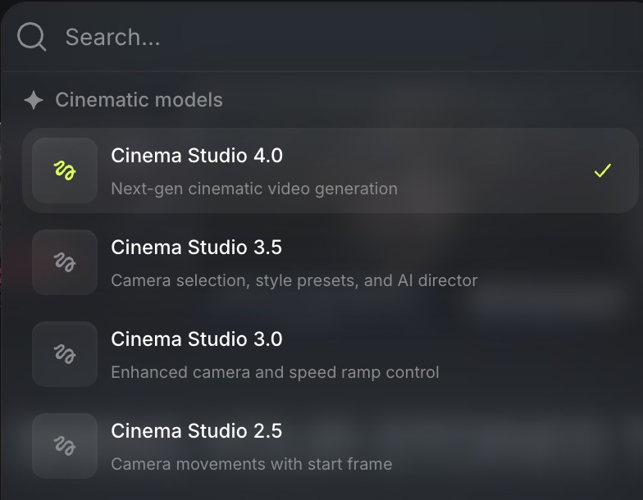
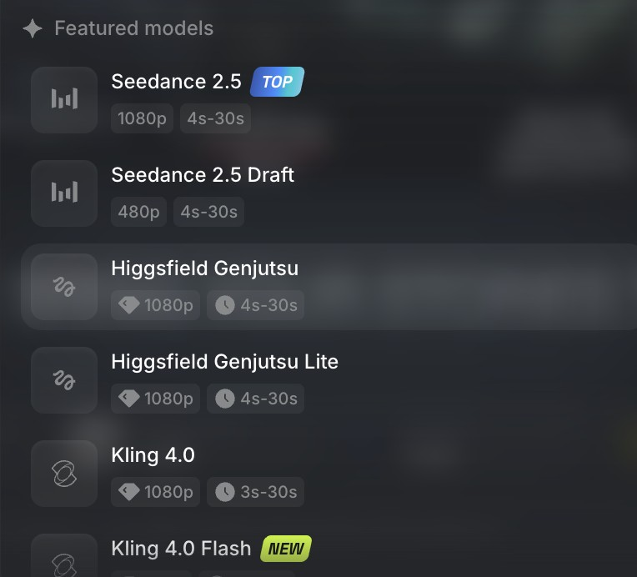
MODELS · WHERE TO CHOOSE
Two menus, one decision: which engine shoots this take?
You will compare two of these on the same prompt in Lab 9
Cinema Studio versions
4.0 is the next-gen cinematic model; 3.5 added camera selection, style presets and AI Director; 3.0 added speed ramps; 2.5 moves the camera from a start frame.
The video model list
Seedance 2.5 (TOP) and its 480p Draft, Genjutsu and Genjutsu Lite, Kling 4.0 and the new 4.0 Flash, each with its resolution and 3–30 s range.
© Tertiary Infotech Academy Pte Ltd
Creating Engaging Videos with Generative AI (GenAI) · TGS-2024043855
26

Slide 27
TOPIC 1
1
Lab 1 — Sign Up and Make Your First 15-Second Video
Create and Edit Video Script Using Generative AI (GenAI)
2
Lab 2 — Write the Script and Shot List with Supercomputer and AI Director
3
Lab 3 — Set the House Rules: Standards, Work Plan and Credit Budget
The impact of AI on video · use cases · Supercomputer scripts · AI Director shot lists · standards & work plans
© Tertiary Infotech Academy Pte Ltd
Creating Engaging Videos with Generative AI (GenAI) · TGS-2024043855
27

Slide 28
COVERS K1 · A1 · A2 · A3
Key Concepts — Topic 1
AI's impact & use cases
A US$2,000 TV ad, a 14-day feature: AI movies, micro dramas, influencers, singers and marketing videos already earn audiences.
The lazy prompt
Format + vibe gets you a clip in one line, but the model then decides your character, world and camera.
1
2
Scripts with Supercomputer
Who / where / what happens, then a script and a numbered shot list, drafted and refined in one chat.
AI Director
Inside a project, AI Director writes the script and an 8-shot storyboard from your brief.
3
4
Standards & guidelines
A one-page sheet: platform specs, consent, licensing, AI disclosure and a Draft-first credit rule.
Work plans & credit budgets
Phases, owners, timelines and a credit budget: 45 credits for a 15 s Draft, 240 for the 1080p final.
5
6
© Tertiary Infotech Academy Pte Ltd
Creating Engaging Videos with Generative AI (GenAI) · TGS-2024043855
28

Slide 29
WHAT YOU'LL DO
Hands-On Labs — Topic 1
Lab 1 — Sign Up and Make Your First 15-Second Video
Two 15-second Draft clips of the same idea, plus a log of what the model decided and three quality issues you spotted.
1
Lab 2 — Write the Script and Shot List with Supercomputer and AI Director
A reviewed 15-second script and a 6-shot shot list in the three-part prompt format, saved in your project brief.
2
Lab 3 — Set the House Rules: Standards, Work Plan and Credit Budget
A one-page standards & guidelines sheet, a phased work plan with timelines and a credit budget, and your own /house-standards skill.
3
© Tertiary Infotech Academy Pte Ltd
Creating Engaging Videos with Generative AI (GenAI) · TGS-2024043855
29

Slide 30
TOPIC 1 · THE IMPACT OF AI ON VIDEO CREATION
AI has changed the economics of video
Budgets, crews and timelines that used to decide who could make video no longer do
US$2K
14 days
45
a national TV ad
Kalshi's NBA Finals spot: about US$2,000 and 15 clips cut from 300–400 generations (The Keyword)
a 95-minute feature
Hell Grind: 15 people, under US$500K (CineD)
credits a test take
one 15-second Seedance 2.5 Draft in Higgsfield, before you commit to 1080p
The new bottleneck is direction: knowing what to ask for, judging the take, and fixing what fails. That is this course.
© Tertiary Infotech Academy Pte Ltd
Creating Engaging Videos with Generative AI (GenAI) · TGS-2024043855
30
Notes:
Sources on slide. Kalshi's view counts (30M+/100M) are the creator's own claims, so quote the cost and the airing.

Slide 31
TOPIC 1 · BEFORE AND AFTER
What AI changes at each stage of production
Stage
Before AI
With AI (in Higgsfield)
Script & storyboard
Writer + storyboard artist, days
Supercomputer / AI Director, minutes; you review and edit
Casting & locations
Auditions, permits, travel
Elements: cast, sets and props generated and saved
The shoot
Crew, camera, lights, a day per scene
Cinema Studio takes: camera, lens, light set in the prompt
Fixes & reshoots
Re-book cast and crew
Replace an object, regenerate one shot, upscale
Sound & music
Composer, voice artist, studio
Native audio, generated soundtrack, consented voice
New risks
—
Likeness, rights, disclosure, quality drift: K4 rules apply
TIP: Ask: which of these jobs disappears, and which becomes more valuable? (Direction, review, compliance.)
© Tertiary Infotech Academy Pte Ltd
Creating Engaging Videos with Generative AI (GenAI) · TGS-2024043855
31

Slide 32
TOPIC 1 · USE CASES
Five ways AI video already earns audiences
AI movie
Hell Grind: a 95-minute Higgsfield feature, 15 people, 14 days (CineD).
AI micro drama
Kling's Mountains & Seas premiered on Kuaishou on 13 Jul 2024: 52M+ views (Caixin).
1
2
AI influencer
Aitana López, an AI model, earns up to €10,000 a month (Euronews).
AI singer
Xania Monet: first AI act on a Billboard radio chart, No. 30 Adult R&B Airplay (Nov 2025).
3
4
AI marketing
Kalshi's NBA Finals ad: about US$2,000, made with Google Veo 3 (The Keyword).
Your turn
Lab 9 ends with your own 15-second ad, published or uploaded to the TMS.
5
6
© Tertiary Infotech Academy Pte Ltd
Creating Engaging Videos with Generative AI (GenAI) · TGS-2024043855
32

Slide 33


USE CASE 1 · AI MOVIE
AI movies: cinema-grade scenes from a prompt
Long-form stories need what Topic 2 teaches: Elements that keep every face and set consistent
▶ Open in YouTube
▶ Open in YouTube
THE FILM
The Most Insane AI Film You'll See Today (Seedance 2.5)
A short film made with Seedance 2.5, the model you will use in Labs 1–9 (Theoretically Media).
ALSO WATCH
Hell Grind — Higgsfield Originals (2026)
95 minutes, under US$500K, 15 people, 14 days (CineD). Billed by Higgsfield as the first AI feature film.
© Tertiary Infotech Academy Pte Ltd
Creating Engaging Videos with Generative AI (GenAI) · TGS-2024043855
33
Notes:
Click a video to play it (PowerPoint needs internet; click Enable Content if the yellow bar appears). Hell Grind did not screen in the official Cannes programme; say so if asked.

Slide 34


USE CASE 2 · AI MICRO DRAMA
AI micro dramas: one-minute episodes, no film set
Short, serial, vertical stories: the format Lab 9's variation prompt practises
◀ THE SHORT
The Healer's Refusal — an AI-generated Chinese micro drama
A vertical, cliff-hanger episode made entirely with AI: the format built for TikTok and YouTube Shorts.
ALSO WATCH
Mountains & Seas: Breaking Waves — Kling AI
Kuaishou's AI micro drama premiered 13 Jul 2024 and passed 52M views (Caixin).
▶ Open in YouTube
WHAT IT MEANS FOR YOU
Two characters, one twist, 9:16. Save the cast as Elements so episode 2 looks like episode 1.
▶ Open in YouTube
© Tertiary Infotech Academy Pte Ltd
Creating Engaging Videos with Generative AI (GenAI) · TGS-2024043855
34

Slide 35

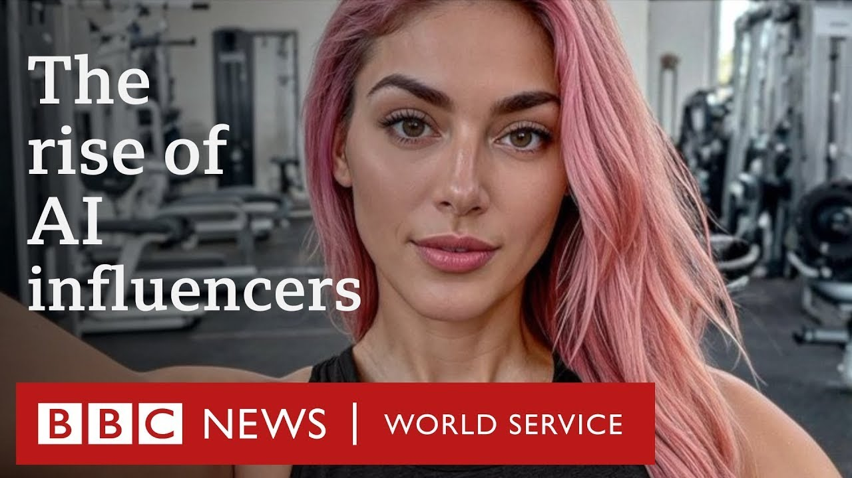
USE CASE 3 · AI INFLUENCER
AI influencers: one face, posting every day
Higgsfield's AI Influencer tool and a saved @char Element make the same face repeatable
◀ THE SHORT
Creating an AI influencer with Higgsfield AI Influencer Studio
A creator builds a consistent virtual influencer inside Higgsfield (Shafin Tech).
ALSO WATCH
Aitana López — BBC World Service
An AI model earning up to €10,000 a month, about €3,000 on average (Euronews).
▶ Open in YouTube
WHAT IT MEANS FOR YOU
Consistency is the product: a character sheet plus an @char Element. Disclose that the person is synthetic (K4).
▶ Open in YouTube
© Tertiary Infotech Academy Pte Ltd
Creating Engaging Videos with Generative AI (GenAI) · TGS-2024043855
35
Notes:
Link to K4: TikTok and YouTube both ask creators to label realistic AI content.

Slide 36


USE CASE 4 · AI SINGER
AI singers: a voice, a song, a music video
Music video, voice and soundtrack: Lab 8 gives you all three inside Higgsfield
◀ THE SHORT
Pretty Little Baby — an AI cover (Ai Music Sunny)
An AI singer covering Connie Francis's song: a fast-growing Shorts genre, and a live rights question.
ALSO WATCH
Xania Monet — How Was I Supposed to Know?
First AI act on a Billboard radio chart: No. 30 on Adult R&B Airplay (Billboard, Nov 2025). Music made with Suno.
▶ Open in YouTube
WHAT IT MEANS FOR YOU
Covering someone else's song or voice needs the rights holder's permission. Original music and your own voice are safe ground.
▶ Open in YouTube
© Tertiary Infotech Academy Pte Ltd
Creating Engaging Videos with Generative AI (GenAI) · TGS-2024043855
36
Notes:
Discussion (K4): is an AI cover of a real artist's song publishable? Who owns the voice? Tie to the Lab 8 consent form.

Slide 37


USE CASE 5 · AI MARKETING
AI marketing: studio-quality ads in minutes
The use case you will run end to end in Lab 9: one product photo to a published ad
◀ THE SHORT
Higgsfield Marketing Studio — UGC ads in seconds
A creator makes UGC-style product ads in Higgsfield's Marketing Studio (AI Tech Pro).
ALSO WATCH
Kalshi NBA Finals ad — PJ Ace (2025)
About US$2,000; 300–400 generations cut to 15 clips with Google Veo 3; aired in Game 3 of the NBA Finals (The Keyword).
▶ Open in YouTube
WHAT IT MEANS FOR YOU
Start from a clean product photo, keep the product identical in every shot, label the ad as AI-generated.
▶ Open in YouTube
© Tertiary Infotech Academy Pte Ltd
Creating Engaging Videos with Generative AI (GenAI) · TGS-2024043855
37
Notes:
The SOLA ad in the Big Picture section was made the same way: one prompt, five shots, 240 credits at 1080p.

Slide 38
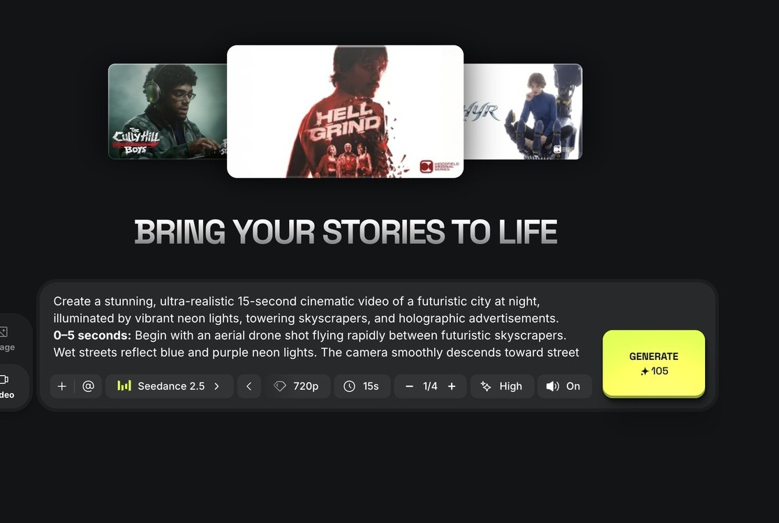
CINEMA STUDIO · VIDEO
Type one line, get fifteen seconds of film
The fastest route from idea to clip, and the one Lab 1 starts with
Describe the scene
Plain English in the prompt box; @ adds a saved character or location.
1
Pick the model
Seedance 2.5 here; switch to Draft for cheap tests.
2
Set quality and length
720p and 15 s cost 105 credits; 1080p costs 240.
1
3
4
2
3
Generate
Credits are shown on the button before you press it.
4
© Tertiary Infotech Academy Pte Ltd
Creating Engaging Videos with Generative AI (GenAI) · TGS-2024043855
38

Slide 39
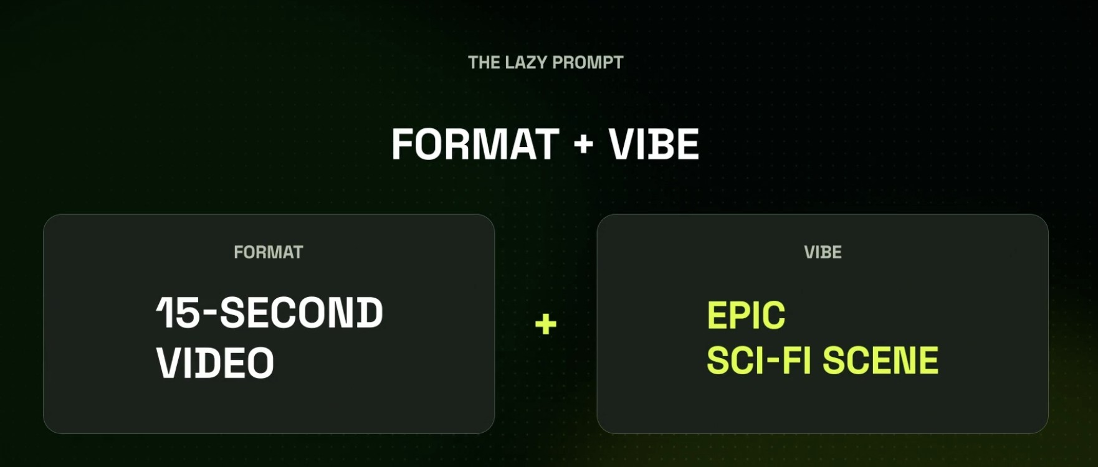
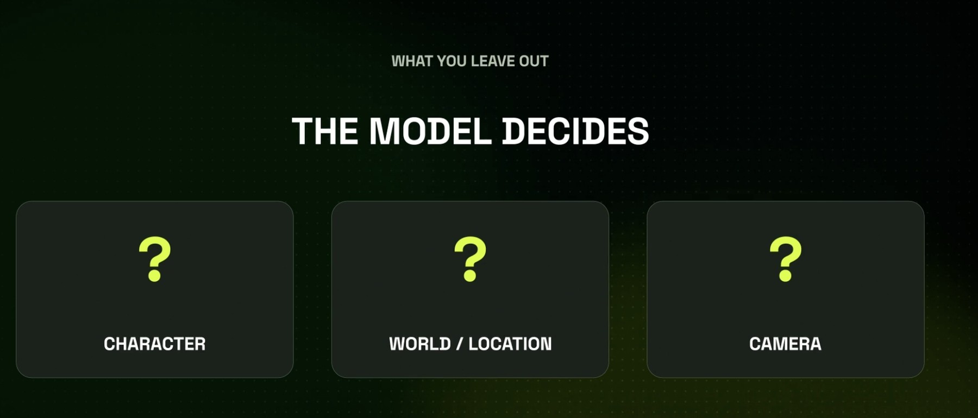
THE LAZY PROMPT
A lazy prompt works, but the model makes your choices
Speed now, inconsistency later: know the trade before you press Generate
Format + vibe
'15-second video' + 'epic sci-fi scene' is enough to generate. That is the lazy prompt you type first in Lab 1.
What you leave out, the model decides
Character, world/location and camera all become the model's guess, so every take tells a different story.
© Tertiary Infotech Academy Pte Ltd
Creating Engaging Videos with Generative AI (GenAI) · TGS-2024043855
39
Notes:
Run the lazy prompt live on Draft (45 credits). Ask the room to name what the model chose for them.

Slide 40

LAB 1 PREVIEW · TESTED IN HIGGSFIELD
We ran the lazy prompt: the model chose everything
Same prompt you will type in Lab 1. No character, no plot: proof that unbriefed means undirected
THE SHOTS WE PROMPTED
Prompt
'Create a 15-second video of an epic sci-fi scene.'
Character
none: the model left people out
World
abstract space and crystal shards
Camera
a warp-speed fly-through, no story beats
Lesson
brief who / where / what happens (Lab 2)
▶ Click to play · Seedance 2.5 Draft · 480p · 16:9 · 15 s · 45 credits · run 9 Nov 2026
© Tertiary Infotech Academy Pte Ltd
Creating Engaging Videos with Generative AI (GenAI) · TGS-2024043855
40
Notes:
Rendered for this course on 9 Nov 2026 as a Seedance 2.5 Draft (45 credits). Learners' takes will differ: that variation is the point.

Slide 41
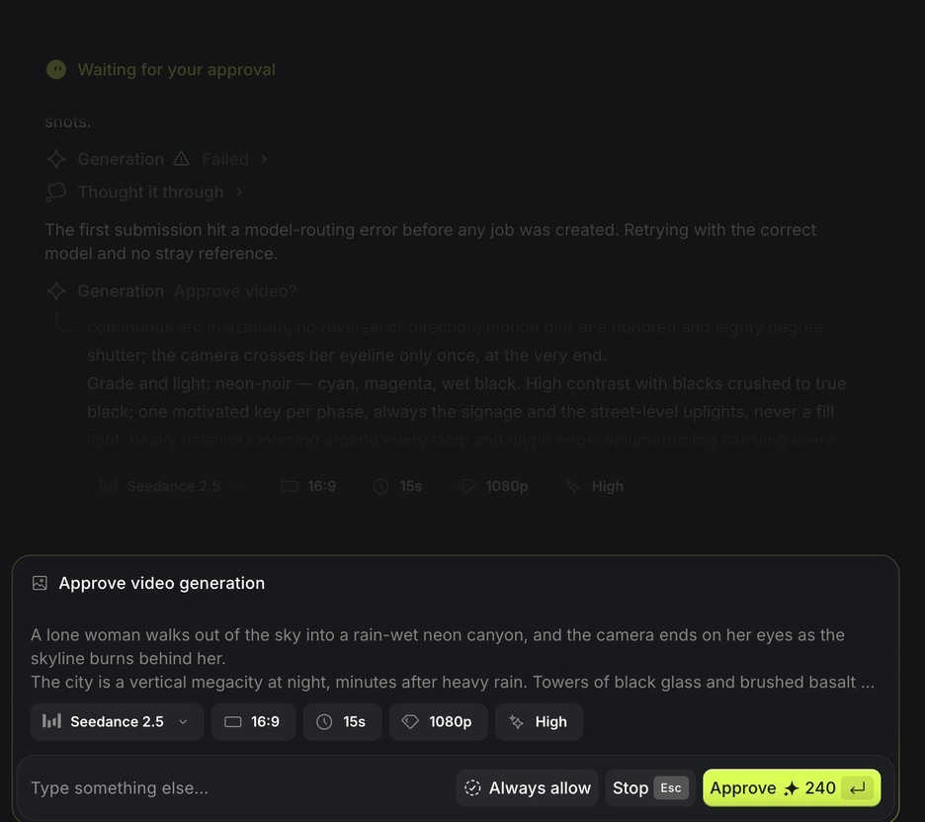
SUPERCOMPUTER · THE APPROVAL CARD
Supercomputer asks before it spends a credit
An agent with a budget gate: you stay the producer
The prompt it wrote
Read the scene, shots and grade it built from your chat.
1
The settings
Model, ratio, length, resolution and quality, all editable.
2
Approve with the price
240 credits for 15 s at 1080p; switch to Draft first.
3
1
Leave 'Always allow' off
Approve each spend by hand in class.
2
4
4
3
© Tertiary Infotech Academy Pte Ltd
Creating Engaging Videos with Generative AI (GenAI) · TGS-2024043855
41
Notes:
Supercomputer is Higgsfield's agent ('powered by Opus 5.5' on the home tile). It can call every Higgsfield tool; the approval card is where a human stays in charge.

Slide 42
K1 · TYPES OF QUALITY ISSUES
Six defects every AI video can have (K1)
Identity drift
The hero's face, hair or clothes change between shots.
Prop teleport
The case swaps hands or vanishes mid-scene.
1
2
Broken physics
Hands merge, liquids melt, people walk through tables.
Audio mismatch
Footsteps without feet, lips out of sync, music over dialogue.
3
4
Garbled text
Signs and labels turn into nonsense letters.
Wrong spec
Wrong ratio, 480p left in the final, cut mid-movement.
5
6
© Tertiary Infotech Academy Pte Ltd
Creating Engaging Videos with Generative AI (GenAI) · TGS-2024043855
42

Slide 43
TOPIC 01 · HANDS-ON
Sign Up and Make Your First 15-Second Video
LAB 1
MAPS TO K1 — spot quality issues; A2 — generate a new video from scratch on a GenAI video platform
Sign up to Higgsfield through the course link, tour the two doors (Supercomputer and Cinema Studio), then make the same 15-second sci-fi clip twice: once from a one-line lazy prompt, once after Supercomputer interviews you. Compare what the model decided for you.
You'll build
Two 15-second Draft clips of the same idea, plus a log of what the model decided and three quality issues you spotted.
Tools: Higgsfield: Cinema Studio (Video), Supercomputer, Seedance 2.5 Draft
© Tertiary Infotech Academy Pte Ltd
Creating Engaging Videos with Generative AI (GenAI) · TGS-2024043855
43

Slide 44
LAB 1 · HOW IT RUNS — FULL STEPS IN THE LEARNER GUIDE
How Lab 1 Runs
1
2
3
4
5
Sign up via the course link
Tour Supercomputer + Cinema Studio
Lazy prompt, Draft take
Supercomputer interviews you
Compare and log issues
© Tertiary Infotech Academy Pte Ltd
Creating Engaging Videos with Generative AI (GenAI) · TGS-2024043855
44

Slide 45
LAB 1 · COPY-AND-ADAPT PROMPTS
Lab 1 — Prompts
PROMPT — THE LAZY PROMPT (FORMAT + VIBE)
Create a 15-second video of an epic sci-fi scene.
PROMPT — MAKE SUPERCOMPUTER INTERVIEW YOU FIRST
I want a 15-second epic sci-fi scene for a cinema-style trailer moment.
Before you write or generate anything, ask me up to five short questions about:
the main character, the world/location, what happens, the camera, and the sound.
Then write the full prompt with timed shots and wait for my approval.
Use Seedance 2.5 Draft, 16:9, 15 seconds, sound on.
© Tertiary Infotech Academy Pte Ltd
Creating Engaging Videos with Generative AI (GenAI) · TGS-2024043855
45

Slide 46
LAB 1 · VERIFY
Sign Up and Make Your First 15-Second Video
✓ Check your work
Both clips are 15 s Drafts in one project; your log names the character, world and camera the model chose and three concrete quality issues, and says which ones the interviewed take fixed.
Detailed step-by-step instructions: Learner Guide + the lab folder in labs/.
© Tertiary Infotech Academy Pte Ltd
Creating Engaging Videos with Generative AI (GenAI) · TGS-2024043855
46

Slide 47
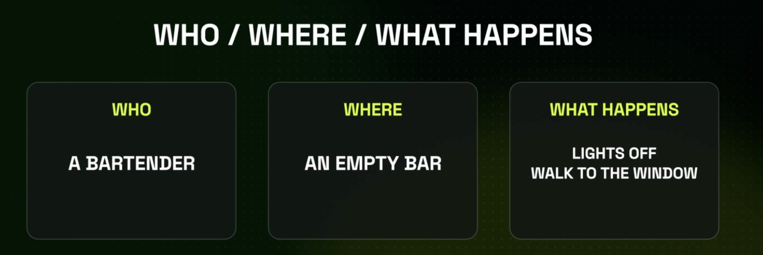
SCRIPT · THE THREE-LINE BRIEF
Brief like a director: who, where, what happens
Three lines remove the three guesses the lazy prompt left to the model
WHO
One character with a job and a look: 'a bartender'.
WHERE
One location you could photograph: 'an empty bar'.
WHAT HAPPENS
One visible action with an ending: 'lights off, walk to the window'.
© Tertiary Infotech Academy Pte Ltd
Creating Engaging Videos with Generative AI (GenAI) · TGS-2024043855
47

Slide 48
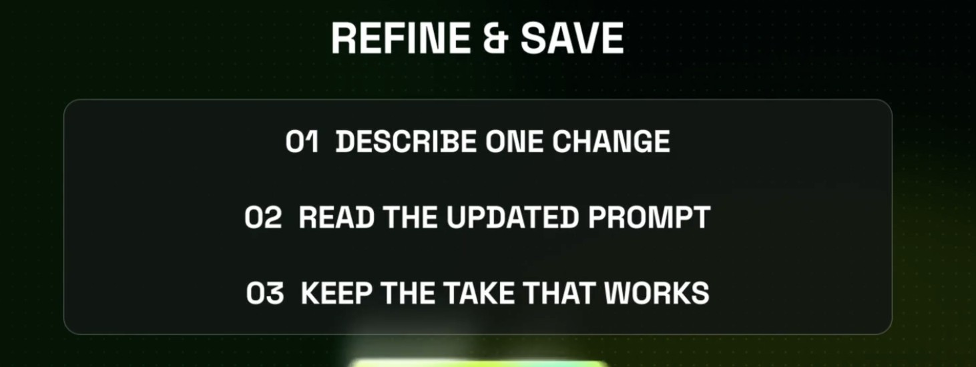
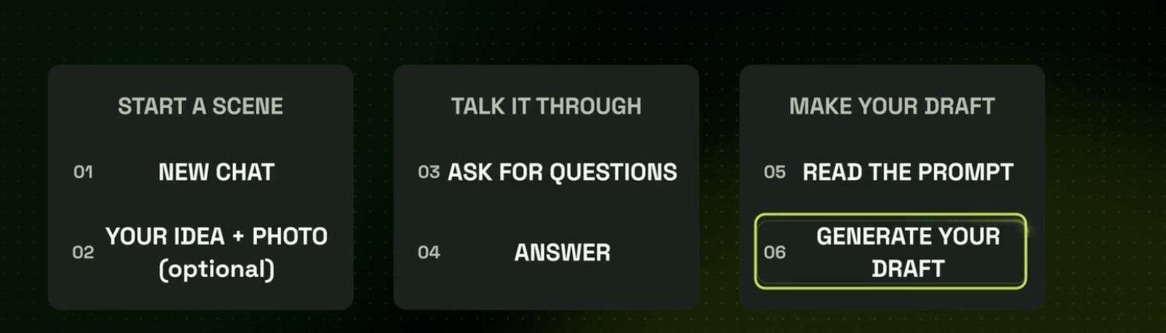
SUPERCOMPUTER · THE WORKING LOOP
Talk the scene through, then refine one change at a time
The loop you will repeat in every lab from here on
Start → talk → draft
New chat, your idea (and a photo if you have one), let it ask questions, answer, read its prompt, generate the draft.
Refine & save
Describe ONE change, read the updated prompt, keep the take that works. One change per run tells you what fixed it.
© Tertiary Infotech Academy Pte Ltd
Creating Engaging Videos with Generative AI (GenAI) · TGS-2024043855
48

Slide 49
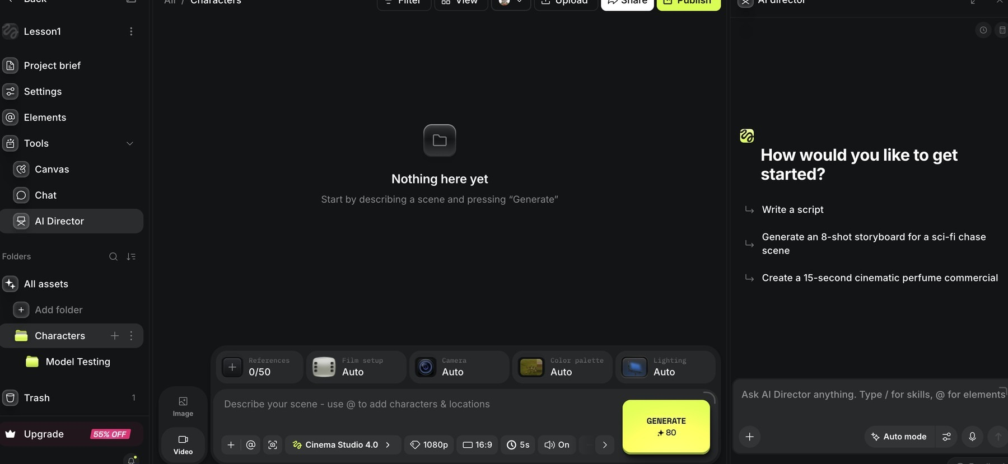
PROJECTS · AI DIRECTOR
AI Director turns a brief into a script and storyboard
Your writers' room lives inside the project, next to the footage
1
2
3
4
1
Project brief
2
Elements
3
AI Director
4
Suggested starts
Where the locked script and shot list live.
The characters, locations and props this project can call.
Opens the director chat inside the project.
'Write a script', 'Generate an 8-shot storyboard', '15-second perfume commercial'.
© Tertiary Infotech Academy Pte Ltd
Creating Engaging Videos with Generative AI (GenAI) · TGS-2024043855
49

Slide 50
A1 · REVIEW THE SCRIPT BEFORE YOU SHOOT
Good Story Elements
Identifiable hero
A protagonist the audience recognises themselves in.
A clear desire
What does the hero want? Ambiguity kills engagement.
1
2
A real obstacle
No obstacle, no story: conflict is the heart of drama.
Action & outcome
The hero acts; the world changes. Show the transformation.
3
4
Resolution
End the story world in a new state, with your call to action.
The story spine
Once upon a time… then one day… but… so… until finally…
5
6
© Tertiary Infotech Academy Pte Ltd
Creating Engaging Videos with Generative AI (GenAI) · TGS-2024043855
50

Slide 51
THE HIGGSFIELD PROMPT FORMAT
Build every prompt in three parts
1
2
3
4
5
Scene context
References
Shots
Sound
Settings
visible action, 1–2 sentences
@elements and their roles
numbered, timed, sized
ambience, foley, dialogue
model, ratio, length, Draft
WRITE IT LIKE A CALL SHEET
Every shot names a size, an action and a camera. The model stops guessing and starts following.
© Tertiary Infotech Academy Pte Ltd
Creating Engaging Videos with Generative AI (GenAI) · TGS-2024043855
51

Slide 52
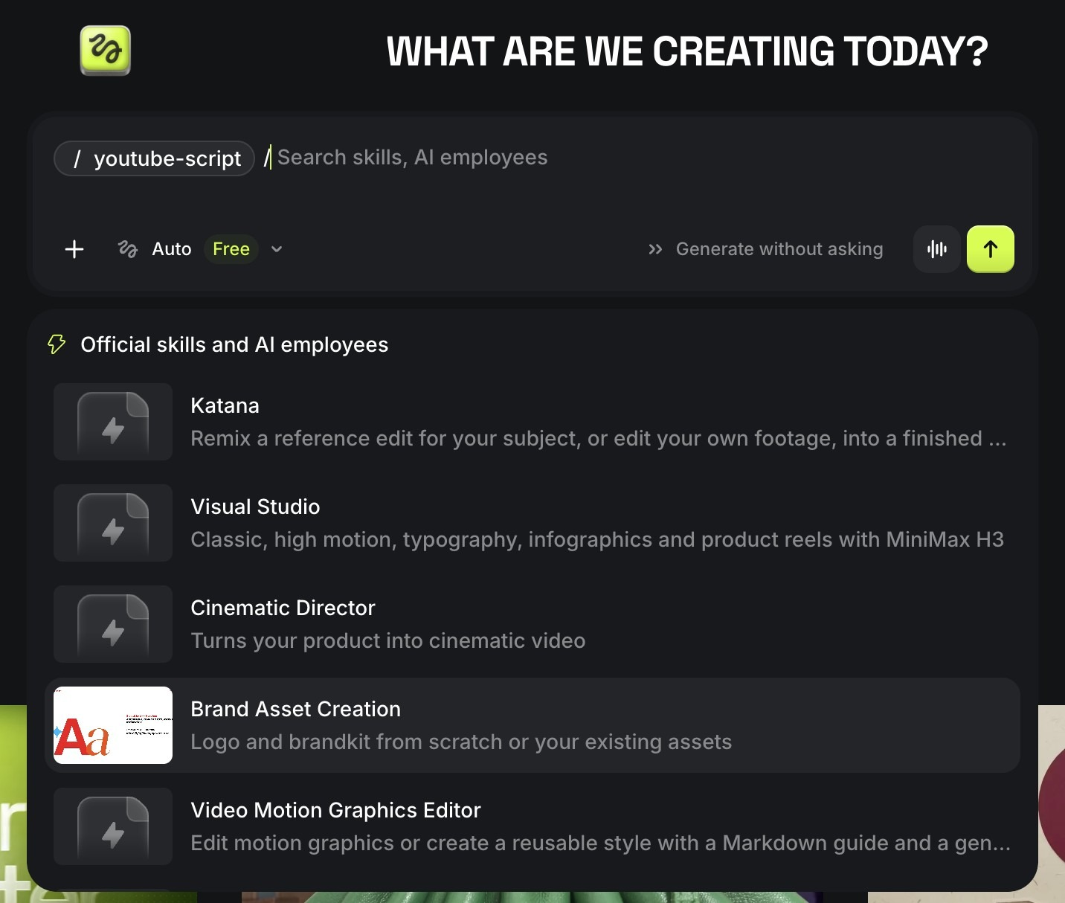
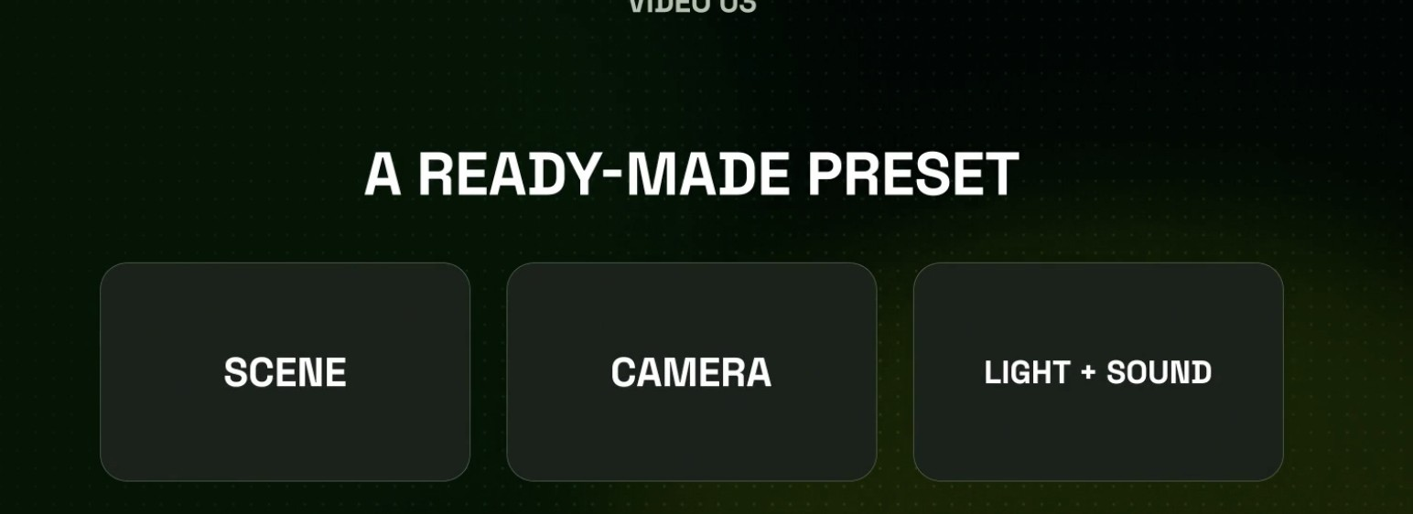
SHORTCUTS · PRESETS AND SKILLS
Ready-made presets and skills do the heavy lifting
Lab 2 uses /youtube-script; Lab 9 uses /product-photoshoot
A preset packs scene, camera, light and sound
Pick one and the model receives a full brief. Good for speed; you still check it fits your story.
Skills: rules for a specific job
Type / in Supercomputer: Katana, Visual Studio, Cinematic Director, Brand Asset Creation, Video Motion Graphics Editor, /youtube-script.
© Tertiary Infotech Academy Pte Ltd
Creating Engaging Videos with Generative AI (GenAI) · TGS-2024043855
52

Slide 53
SUPERCOMPUTER · SKILLS
Add a skill to Supercomputer: three ways
Install from the Marketplace
Skills in the left sidebar → browse official and community skills → Install. Higgsfield calls Skills 'installable workflows'.
Import what you already have
Bring your skills and memory from Claude, Claude Code, Codex or ChatGPT (the import uses the Higgsfield MCP connection).
1
2
Create your own
A skill is rules + guidelines for one job: when to use it, the steps, the style rules, the output format.
Run it with a slash
Type / in the Supercomputer prompt and pick the skill: /youtube-script, /product-photoshoot, /house-standards.
3
4
© Tertiary Infotech Academy Pte Ltd
Creating Engaging Videos with Generative AI (GenAI) · TGS-2024043855
53
Notes:
Sources: higgsfield.ai/supercomputer-intro (Skills = installable workflows from the Marketplace; import from Claude, Claude Code, Codex, ChatGPT). Confirm the exact Create/Import button labels on your own account before class; the UI changes often.

Slide 54
TOPIC 01 · HANDS-ON
Write the Script and Shot List with Supercomputer and AI Director
LAB 2
MAPS TO A1 — review scripts to conceptualise the edits needed; A2 — edit video scripts with GenAI
Turn a three-line idea (who, where, what happens) into a 15-second script and a timed shot list. AI Director drafts it inside your project; you review it against the story elements and decide the edits: shot sizes, cuts, camera and sound. Then you refine it one change at a time.
You'll build
A reviewed 15-second script and a 6-shot shot list in the three-part prompt format, saved in your project brief.
Tools: Higgsfield: Projects, AI Director, Supercomputer (/youtube-script skill)
© Tertiary Infotech Academy Pte Ltd
Creating Engaging Videos with Generative AI (GenAI) · TGS-2024043855
54

Slide 55
LAB 2 · HOW IT RUNS — FULL STEPS IN THE LEARNER GUIDE
How Lab 2 Runs
1
2
3
4
5
Who / where / what happens
AI Director drafts script
Review against story elements
Rewrite as a 3-part prompt
Refine one change at a time
© Tertiary Infotech Academy Pte Ltd
Creating Engaging Videos with Generative AI (GenAI) · TGS-2024043855
55

Slide 56
LAB 2 · COPY-AND-ADAPT PROMPTS
Lab 2 — Prompts (1/2)
PROMPT — BRIEF AI DIRECTOR — WHO / WHERE / WHAT HAPPENS
WHO: a bartender in her thirties, tired but proud of her bar.
WHERE: her empty neighbourhood bar after closing time.
WHAT HAPPENS: she switches the lights off one by one and walks to the window as the city lights come on.
Write a 15-second cinematic script, then a 6-shot storyboard with shot sizes and timings.
PROMPT — THREE-PART PROMPT SKELETON
Scene context: <the visible action in one or two sentences>.
References: <@element — role, 100% as shown in the reference image>.
Shots (cut between each):
1. 0–3s: <shot size>, <action>, <camera>.
2. 3–6s: ...
Sound: <ambience>, <footsteps/clothing>, <dialogue or none>.
© Tertiary Infotech Academy Pte Ltd
Creating Engaging Videos with Generative AI (GenAI) · TGS-2024043855
56

Slide 57
LAB 2 · COPY-AND-ADAPT PROMPTS
Lab 2 — Prompts (2/2)
PROMPT — SCRIPT CRITIQUE
Act as a film editor. Check this script for: weak opening shot, unclear hero, no obstacle, no visual payoff, and shots that cannot be filmed in 15 seconds. List each issue, then rewrite only the weakest shot.
© Tertiary Infotech Academy Pte Ltd
Creating Engaging Videos with Generative AI (GenAI) · TGS-2024043855
57

Slide 58
LAB 2 · VERIFY
Write the Script and Shot List with Supercomputer and AI Director
✓ Check your work
The script fits 15 s, every shot has a size, a camera instruction and a time, the story-elements review names at least two edits you made, and the prompt is in the three-part format.
Detailed step-by-step instructions: Learner Guide + the lab folder in labs/.
© Tertiary Infotech Academy Pte Ltd
Creating Engaging Videos with Generative AI (GenAI) · TGS-2024043855
58

Slide 59
ONE SCENE ≠ EVERY PLATFORM
Tailoring the cut to the platform
YouTube
TikTok / Shorts
Instagram Reels
Length
60 s – 10 min
15 – 60 s
15 – 90 s
Ratio
16:9 landscape
9:16 vertical
9:16 vertical
Pacing
Build with structure
Hook in 1–3 s, fast cuts
Aesthetic-first, fast
Captions
Recommended
Essential (muted viewing)
Essential
AI label
Disclose realistic AI content
AI-generated label
Label AI content
TIP: Higgsfield's Reframe turns a 16:9 take into 9:16; plan the safe area when you write the shots.
© Tertiary Infotech Academy Pte Ltd
Creating Engaging Videos with Generative AI (GenAI) · TGS-2024043855
59

Slide 60
A3 · BUDGET THE WORK PLAN IN CREDITS
Draft first: the cheapest quality gate you have
Read on Higgsfield, 9 Nov 2026: put these numbers in your Lab 3 work plan
45
240
7
credits
a 15 s Seedance 2.5 Draft at 480p
credits
the same 15 s at 1080p, 5× the price
days
to finalise any Draft you keep at 1080p
Rule for every lab: test the idea on Draft, finalise only the take you would show a client.
© Tertiary Infotech Academy Pte Ltd
Creating Engaging Videos with Generative AI (GenAI) · TGS-2024043855
60

Slide 61
LAB 3 PREVIEW · CREATE YOUR OWN SKILL
Turn your standards sheet into a skill
Part of the skill
What you write
Example: /house-standards
Name
short, lower-case, hyphenated
house-standards
When to use
the job it does
Every video for our agency's clients
Rules
the non-negotiables
Saved Elements only; 1080p finals; AI label on; no real likeness without consent
Steps
the order of work
Draft 480p → review → finalise 1080p → checklist → export 16:9 + 9:16
Output format
what it must hand back
Prompt in three parts + a credit estimate + a pass/fail checklist
TIP: A skill turns a one-off standards document into a rule the agent follows on every job: the A2 standards become enforced, not just written.
© Tertiary Infotech Academy Pte Ltd
Creating Engaging Videos with Generative AI (GenAI) · TGS-2024043855
61

Slide 62
TOPIC 01 · HANDS-ON
Set the House Rules: Standards, Work Plan and Credit Budget
LAB 3
MAPS TO K1 — quality issues to prevent; A2 — develop editing standards and guidelines; A3 — develop work plans and timelines
Have Supercomputer draft the two documents every Higgsfield production needs: a one-page standards and guidelines sheet (platform specs, legal and AI-disclosure rules, quality gates) and a post-production work plan with timelines and a credit budget built on real Draft and 1080p costs.
You'll build
A one-page standards & guidelines sheet, a phased work plan with timelines and a credit budget, and your own /house-standards skill.
Tools: Higgsfield: Supercomputer (Ask mode, Skills)
© Tertiary Infotech Academy Pte Ltd
Creating Engaging Videos with Generative AI (GenAI) · TGS-2024043855
62

Slide 63
LAB 3 · HOW IT RUNS — FULL STEPS IN THE LEARNER GUIDE
How Lab 3 Runs
1
2
3
4
5
Draft standards with Supercomputer
Add legal + AI-disclosure rules
Build the work plan + credits
Save the rules as a skill
Test /house-standards
© Tertiary Infotech Academy Pte Ltd
Creating Engaging Videos with Generative AI (GenAI) · TGS-2024043855
63

Slide 64
LAB 3 · COPY-AND-ADAPT PROMPTS
Lab 3 — Prompts (1/3)
PROMPT — STANDARDS & GUIDELINES SHEET
Draft a one-page video standards & guidelines sheet for a Singapore agency making 15–30 second AI videos in Higgsfield.
Cover: resolution and frame rate; aspect ratio per platform (YouTube 16:9, TikTok/Reels/Shorts 9:16); audio level and captions;
branding; character and location consistency (saved Elements only); commercial-use rights on our plan;
PDPA consent for real faces and voices; AI-content disclosure labels on TikTok and YouTube; IMDA/ASAS advertising codes.
Format as a table.
© Tertiary Infotech Academy Pte Ltd
Creating Engaging Videos with Generative AI (GenAI) · TGS-2024043855
64

Slide 65
LAB 3 · COPY-AND-ADAPT PROMPTS
Lab 3 — Prompts (2/3)
PROMPT — WORK PLAN WITH TIMELINES AND CREDITS
Create a post-production work plan for a 15-second promo due in 3 working days, made entirely in Higgsfield.
Phases: script lock, Elements (characters, locations, props), 480p Draft takes, 1080p finals, fix & finish
(replace, upscale, captions, music), client review, export 16:9 + 9:16, publish.
For each phase give owner, duration, dependency, deliverable and credits (45 per 15 s Draft, 240 per 15 s 1080p final,
max three Drafts per shot). Format as a timeline table with a credit total.
© Tertiary Infotech Academy Pte Ltd
Creating Engaging Videos with Generative AI (GenAI) · TGS-2024043855
65

Slide 66
LAB 3 · COPY-AND-ADAPT PROMPTS
Lab 3 — Prompts (3/3)
PROMPT — SAVE THE RULES AS A SKILL
Save these standards as a reusable skill named house-standards.
When to use: every video we make for clients.
Rules: saved Elements only; Draft at 480p before any 1080p final; 1080p finals; 16:9 and 9:16 exports;
AI-generated label on; no real person's face or voice without written consent; music cleared for commercial use.
Steps: brief -> three-part prompt -> Draft -> review -> finalise -> quality checklist -> export.
Output: the three-part prompt, a credit estimate and a pass/fail checklist.
© Tertiary Infotech Academy Pte Ltd
Creating Engaging Videos with Generative AI (GenAI) · TGS-2024043855
66

Slide 67
LAB 3 · VERIFY
Set the House Rules: Standards, Work Plan and Credit Budget
✓ Check your work
The sheet names concrete specs per platform and at least three legal or disclosure rules; the plan covers every phase to publishing within 3 days and its credit total matches 45/240 rates; /house-standards answers a test idea with your rules applied.
Detailed step-by-step instructions: Learner Guide + the lab folder in labs/.
© Tertiary Infotech Academy Pte Ltd
Creating Engaging Videos with Generative AI (GenAI) · TGS-2024043855
67

Slide 68
TOPIC RECAP · WHAT YOU CAN NOW DO
Recap — Create and Edit Video Script Using Generative AI (GenAI)
Lab 1 — Sign Up and Make Your First 15-Second Video
You built: Two 15-second Draft clips of the same idea, plus a log of what the model decided and three quality issues you spotted.
1
Lab 2 — Write the Script and Shot List with Supercomputer and AI Director
You built: A reviewed 15-second script and a 6-shot shot list in the three-part prompt format, saved in your project brief.
2
Lab 3 — Set the House Rules: Standards, Work Plan and Credit Budget
You built: A one-page standards & guidelines sheet, a phased work plan with timelines and a credit budget, and your own /house-standards skill.
3
© Tertiary Infotech Academy Pte Ltd
Creating Engaging Videos with Generative AI (GenAI) · TGS-2024043855
68

Slide 69
TOPIC 2
1
Lab 4 — Build Your Elements: Characters, Locations and Props
Improve Video Footage on GenAI-Powered Video Platforms
2
Lab 5 — Direct Shots and Takes in Cinema Studio
3
Lab 6 — Cut, Caption and Assess the Scene
Elements: characters, locations, props · references · Cinema Studio shots & takes · Draft mode · assess the cut
© Tertiary Infotech Academy Pte Ltd
Creating Engaging Videos with Generative AI (GenAI) · TGS-2024043855
69

Slide 70
COVERS K2 · K3 · A4 · A5
Key Concepts — Topic 2
Elements
Save a character, location or prop once with an @handle and reuse it in every shot: the fix for drifting faces and sets.
References
Up to 50 per generation (30 images, 10 videos, 10 audio), each given a role: character, location, camera move or voice.
1
2
Shots & takes
One continuous shot or multishot with cuts; each run is a take you keep, compare or replace.
Cinematic controls
Camera body, lens, aperture, movement, lighting, colour palette, genre, era and tempo.
3
4
Draft mode
Seedance 2.5 Draft renders 480p for 45 credits; finalise only the take that works at 1080p.
Assessing footage
Resolution, continuity, motion, audio, pacing and compliance, judged take by take.
5
6
© Tertiary Infotech Academy Pte Ltd
Creating Engaging Videos with Generative AI (GenAI) · TGS-2024043855
70

Slide 71
WHAT YOU'LL DO
Hands-On Labs — Topic 2
Lab 4 — Build Your Elements: Characters, Locations and Props
Five saved Elements, two characters, two locations and one prop, each with a reference image and an @handle.
4
Lab 5 — Direct Shots and Takes in Cinema Studio
Four Draft takes of one scene and one 1080p final of the best take, made from your Elements.
5
Lab 6 — Cut, Caption and Assess the Scene
A captioned 15–30 s cut in 16:9 and 9:16 with a scored quality checklist and a list of storytelling improvements.
6
© Tertiary Infotech Academy Pte Ltd
Creating Engaging Videos with Generative AI (GenAI) · TGS-2024043855
71

Slide 72
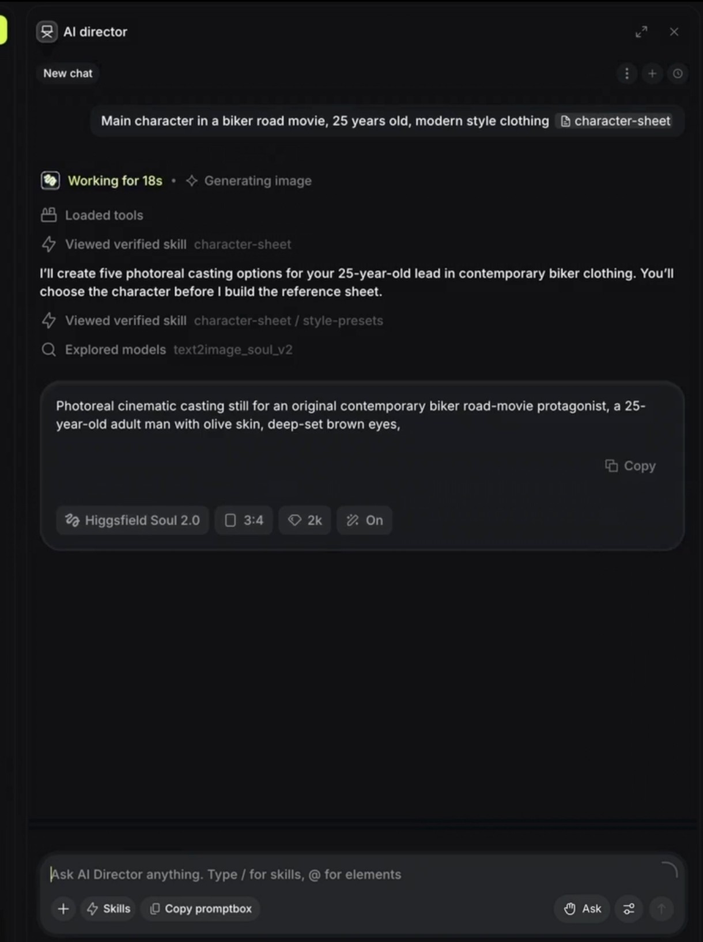
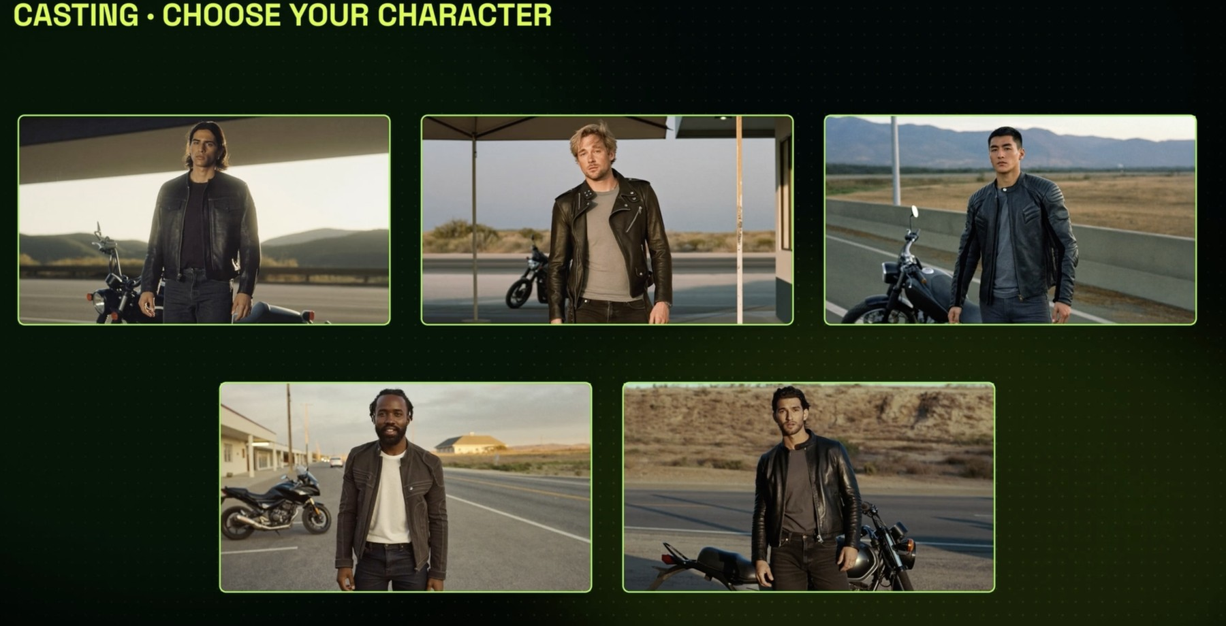
ELEMENTS · CHARACTERS
Cast your lead before you shoot a frame
A cast you chose on purpose beats a face the model invents every take
Ask Supercomputer to cast
'Main character in a biker road movie, 25, modern clothing'. It loads the character-sheet skill and writes a casting prompt for Soul 2.0.
Choose from five options
Five photoreal candidates. You pick one; only then does it build the reference sheet.
© Tertiary Infotech Academy Pte Ltd
Creating Engaging Videos with Generative AI (GenAI) · TGS-2024043855
72

Slide 73
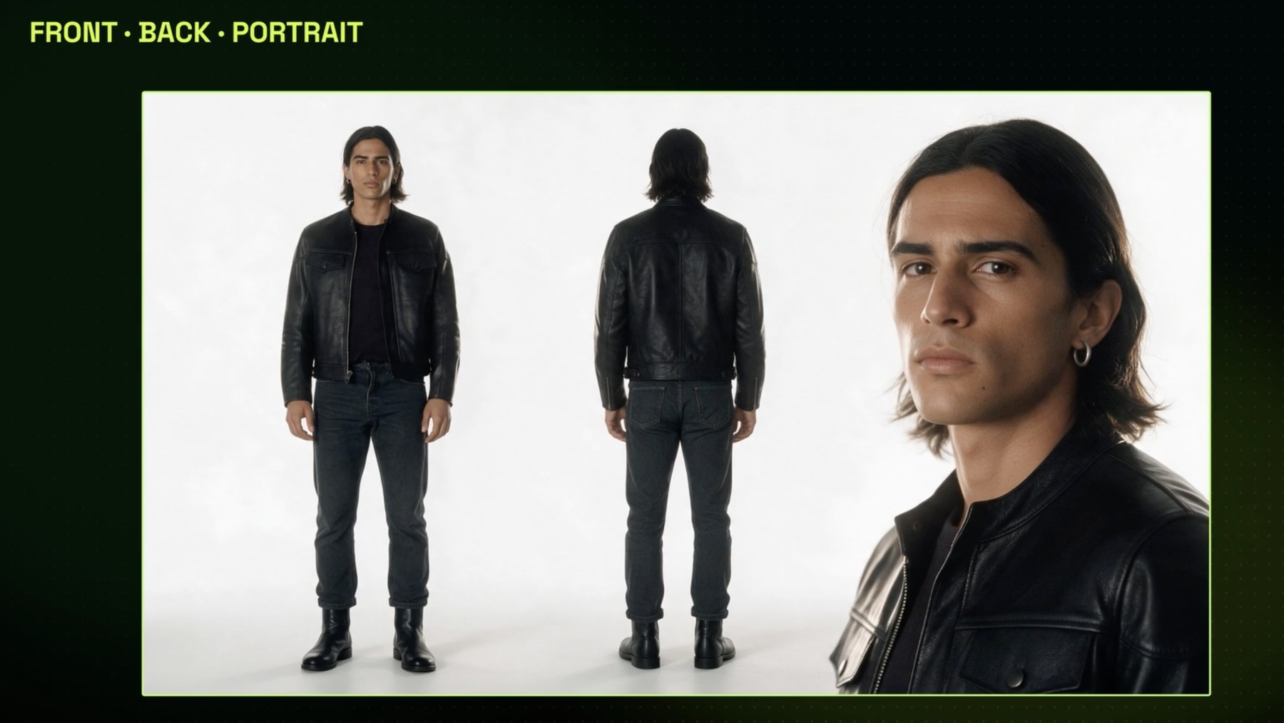
ELEMENTS · CHARACTER SHEET
One sheet, three views: the reference every shot obeys
Plain background, consistent light: the model copies exactly what it sees
Full body, front
Clothes, shoes, proportions.
Full body, back
What the camera sees when he walks away.
Face portrait
The identity the model locks onto.
© Tertiary Infotech Academy Pte Ltd
Creating Engaging Videos with Generative AI (GenAI) · TGS-2024043855
73

Slide 74
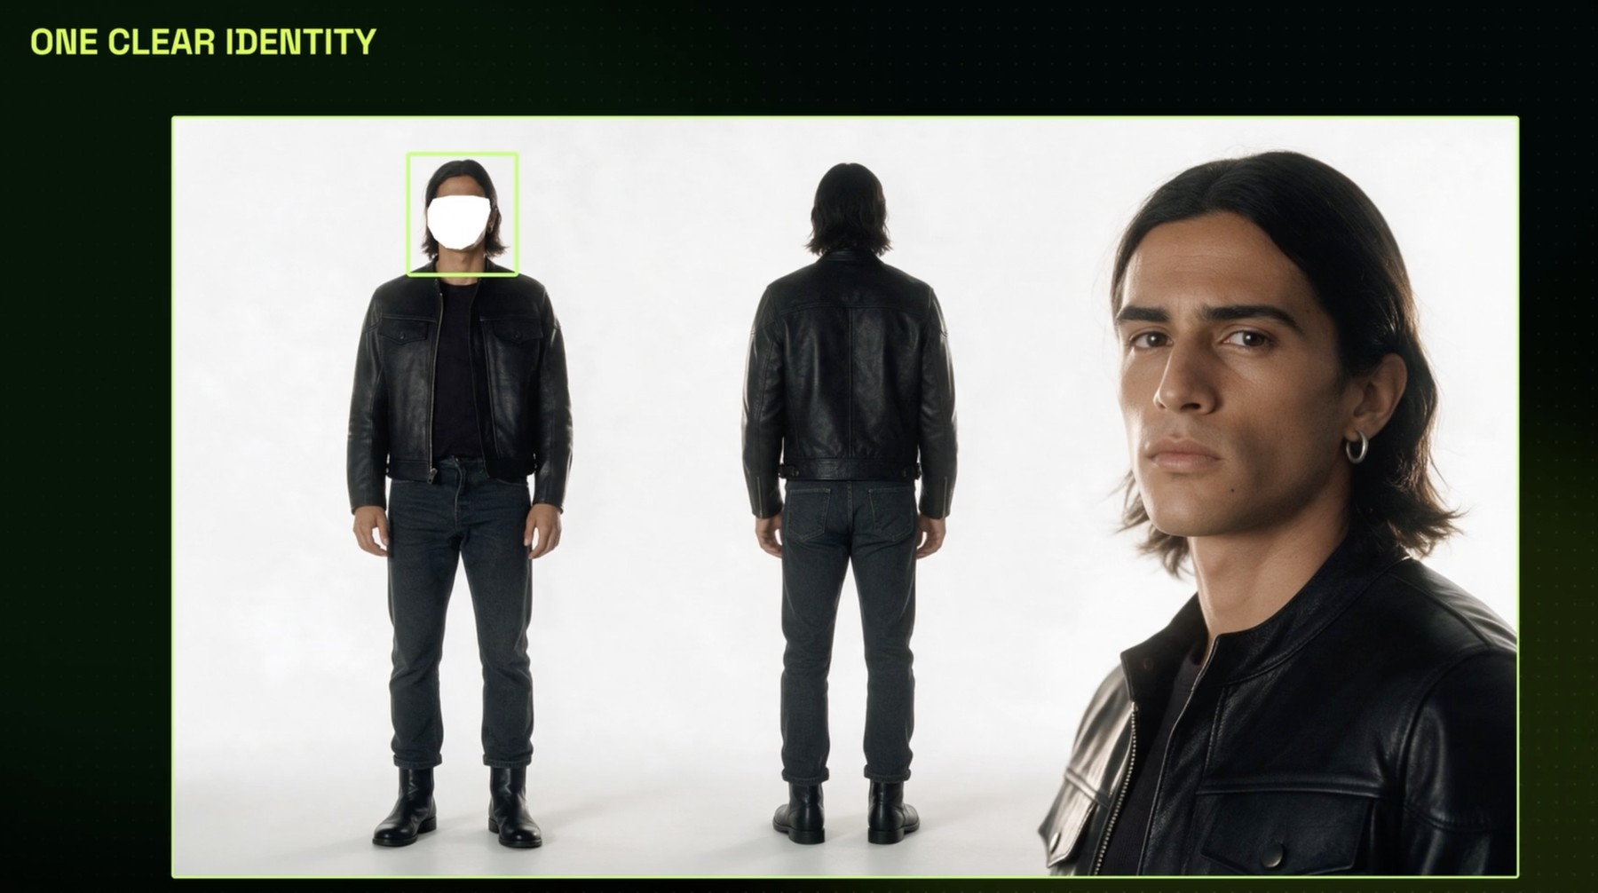
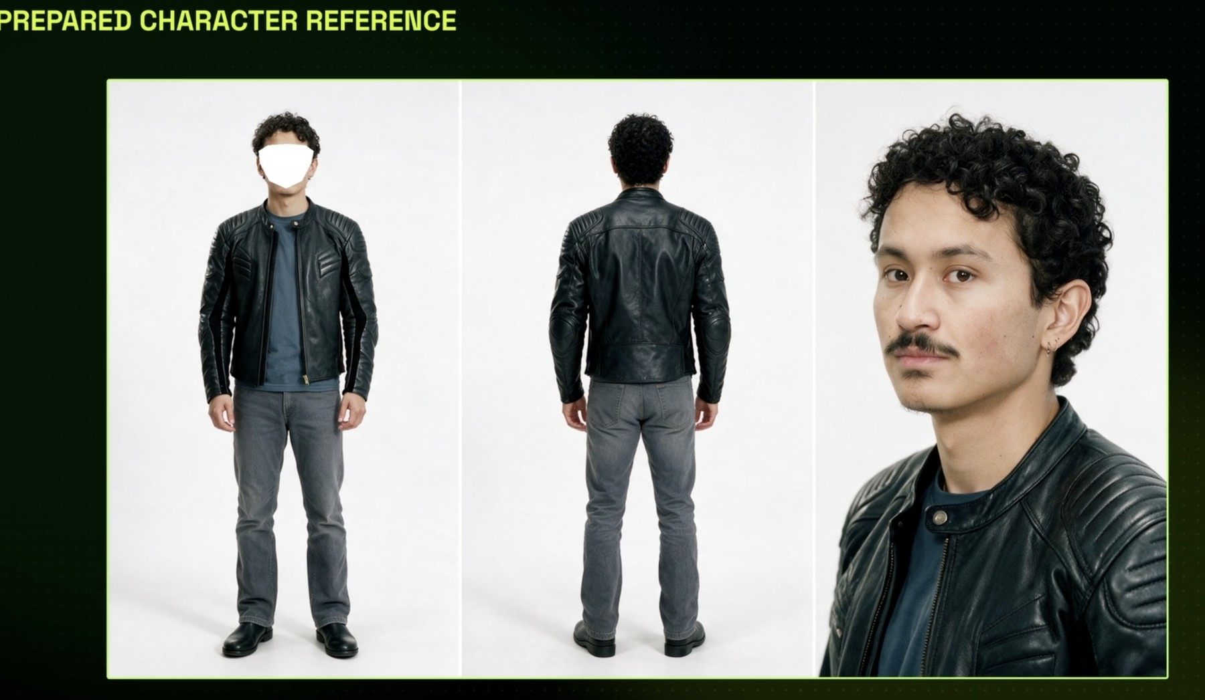
ELEMENTS · CONSISTENCY
Same face, every shot: identity is what a sheet protects
Identity drift is defect no. 1 (K1); a reference sheet is the fix (K2)
Identity locked
The face box marks what the model must keep. The sheet carries the jacket, the jeans and the earring too.
A second character, same rules
The friend gets his own sheet, so two people can share a shot without swapping faces.
© Tertiary Infotech Academy Pte Ltd
Creating Engaging Videos with Generative AI (GenAI) · TGS-2024043855
74

Slide 75
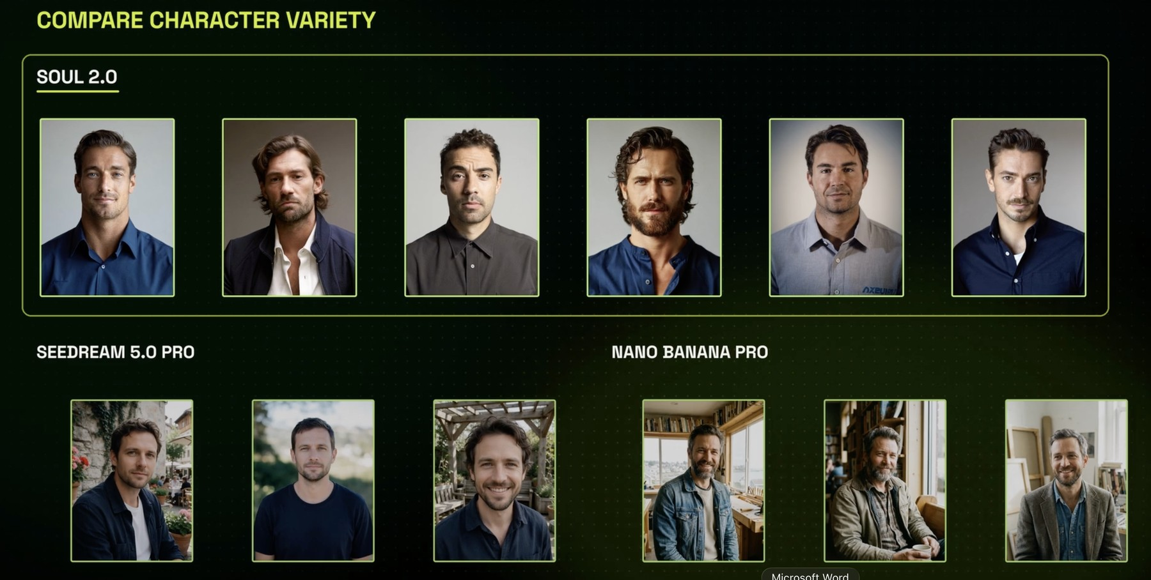
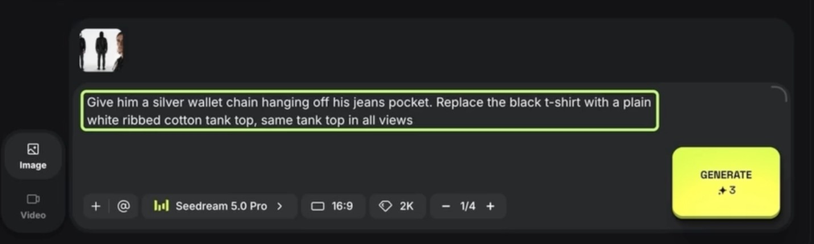
ELEMENTS · REFINE THE CHARACTER
Edit one detail and keep it in every view
Fix wardrobe on the sheet, not shot by shot
A targeted edit
'Give him a silver wallet chain… white ribbed tank top, same in all views.' Seedream 5.0 Pro, 3 credits.
Different models, different casts
Soul 2.0, Seedream 5.0 Pro and Nano Banana Pro each read the same brief their own way.
© Tertiary Infotech Academy Pte Ltd
Creating Engaging Videos with Generative AI (GenAI) · TGS-2024043855
75

Slide 76
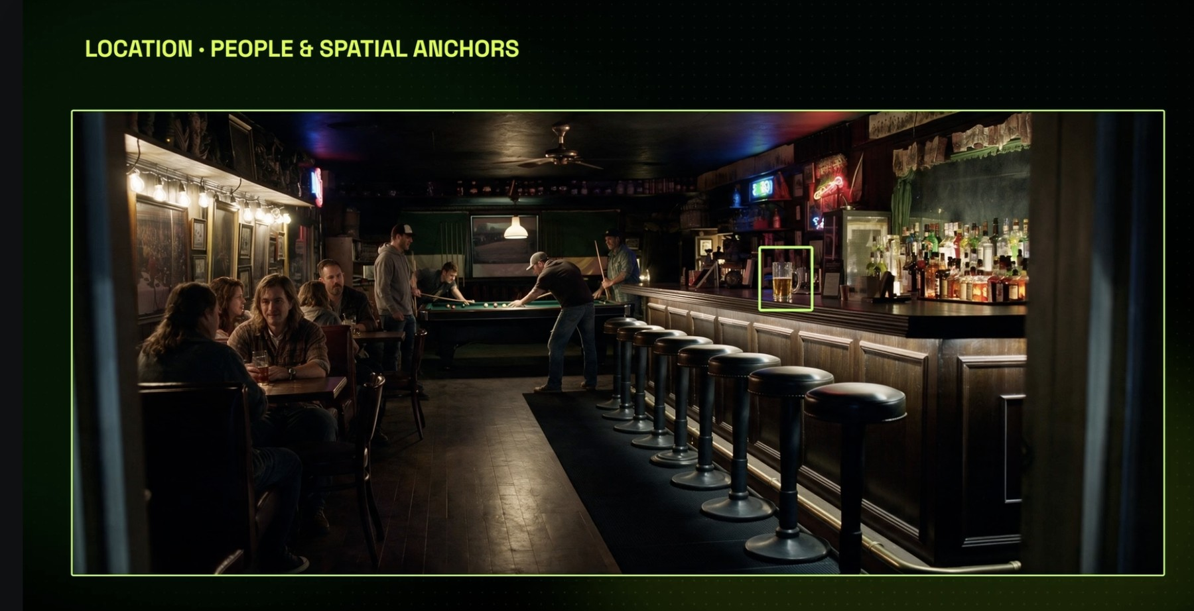
ELEMENTS · LOCATIONS
Build locations with anchors you can name in a shot
'He sits on the third stool' only works if the stool exists in the reference
Spatial anchors
The counter, the stools, the pool table, the window: things a shot can point at.
People optional
Extras give scale; your saved characters will replace them.
Save it
loc_bar-interior becomes @loc_bar-interior in every prompt.
© Tertiary Infotech Academy Pte Ltd
Creating Engaging Videos with Generative AI (GenAI) · TGS-2024043855
76

Slide 77
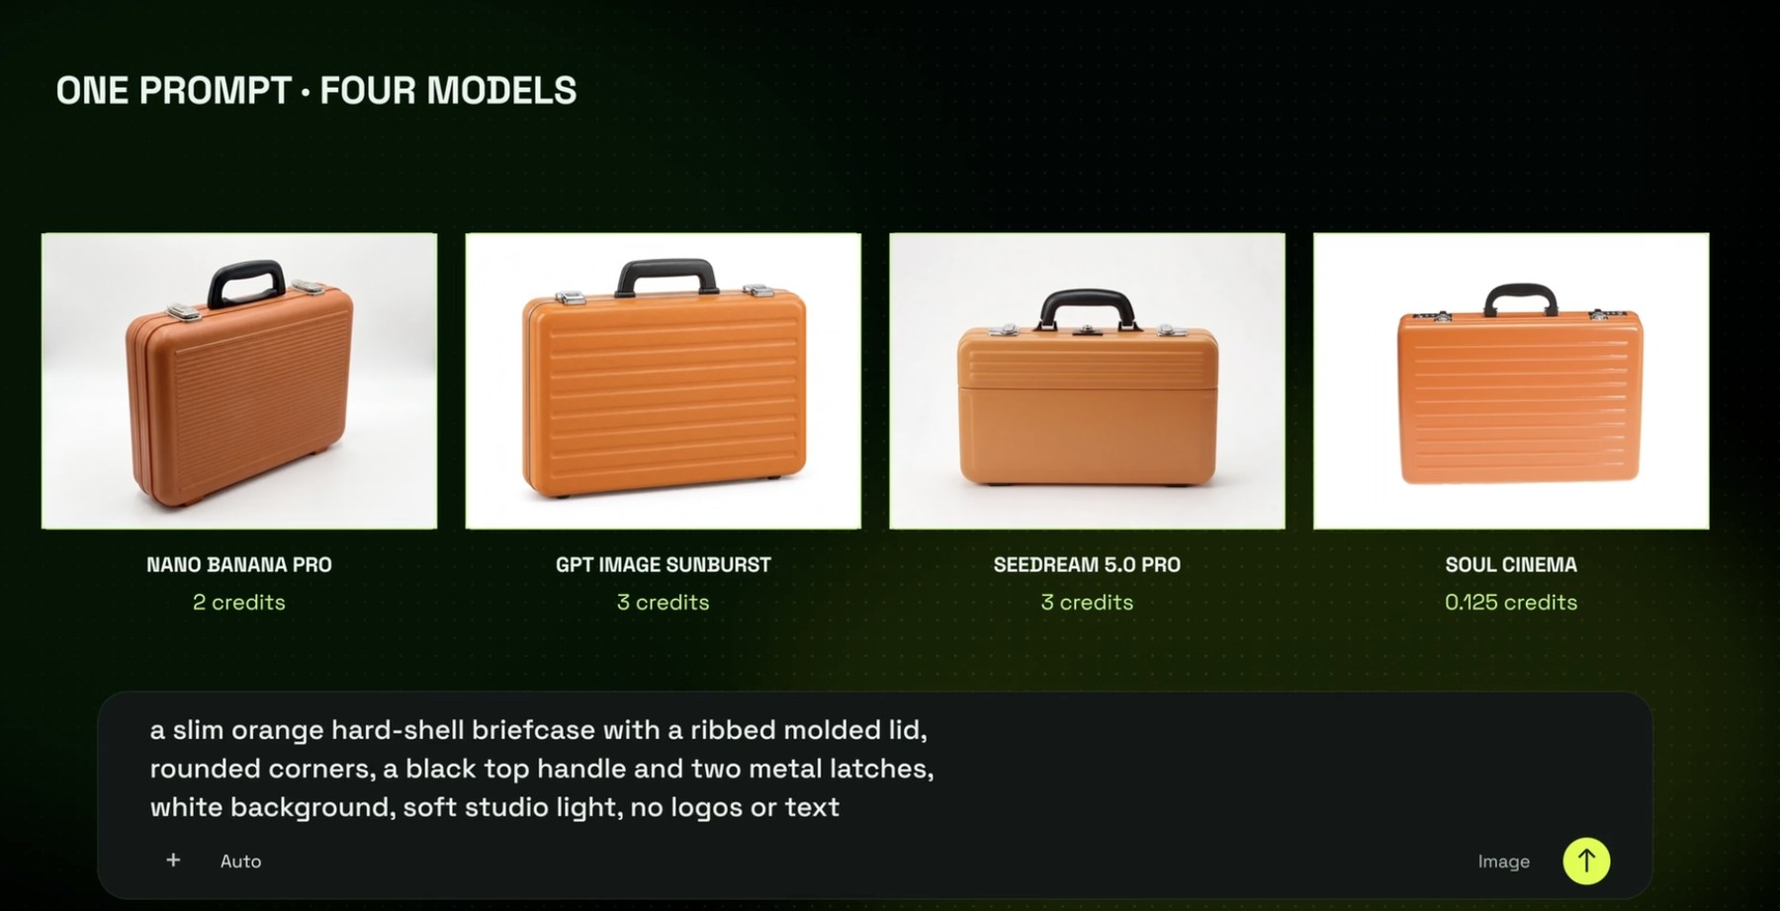
ELEMENTS · PROPS
A prop on four models: compare before you commit
The cheapest image is not always the cheapest choice: a wrong prop costs a re-shoot
Same prompt
A slim orange hard-shell briefcase, white background, no logos.
Different cost
Nano Banana Pro 2 credits, GPT Image Sunburst 3, Seedream 5.0 Pro 3, Soul Cinema 0.125.
Pick on fit
Shape, colour and detail that survive a close-up.
© Tertiary Infotech Academy Pte Ltd
Creating Engaging Videos with Generative AI (GenAI) · TGS-2024043855
77

Slide 78
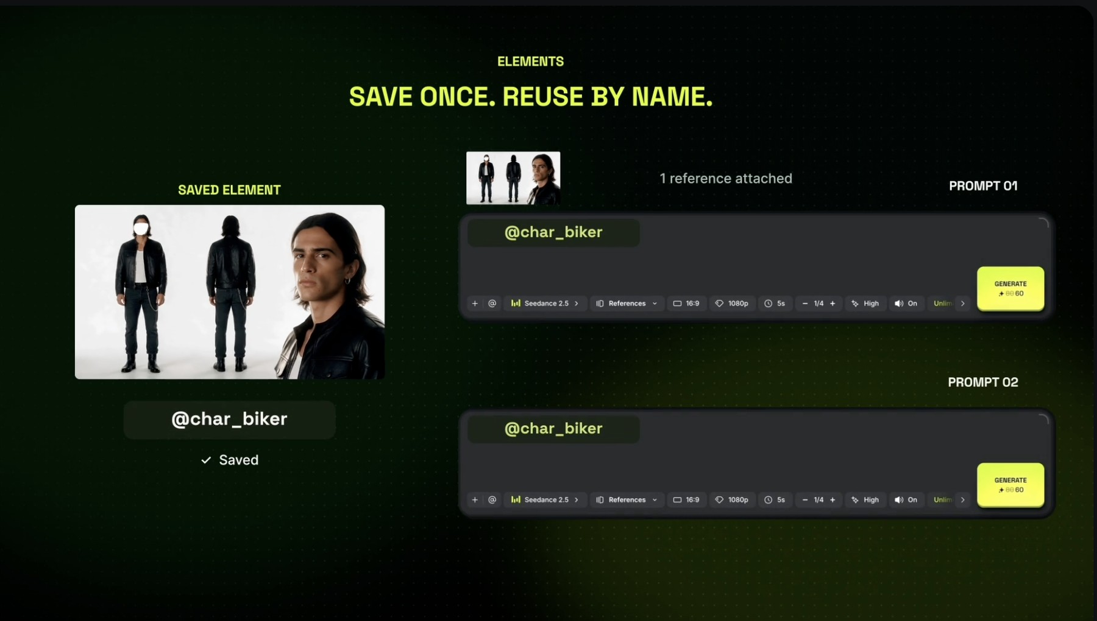
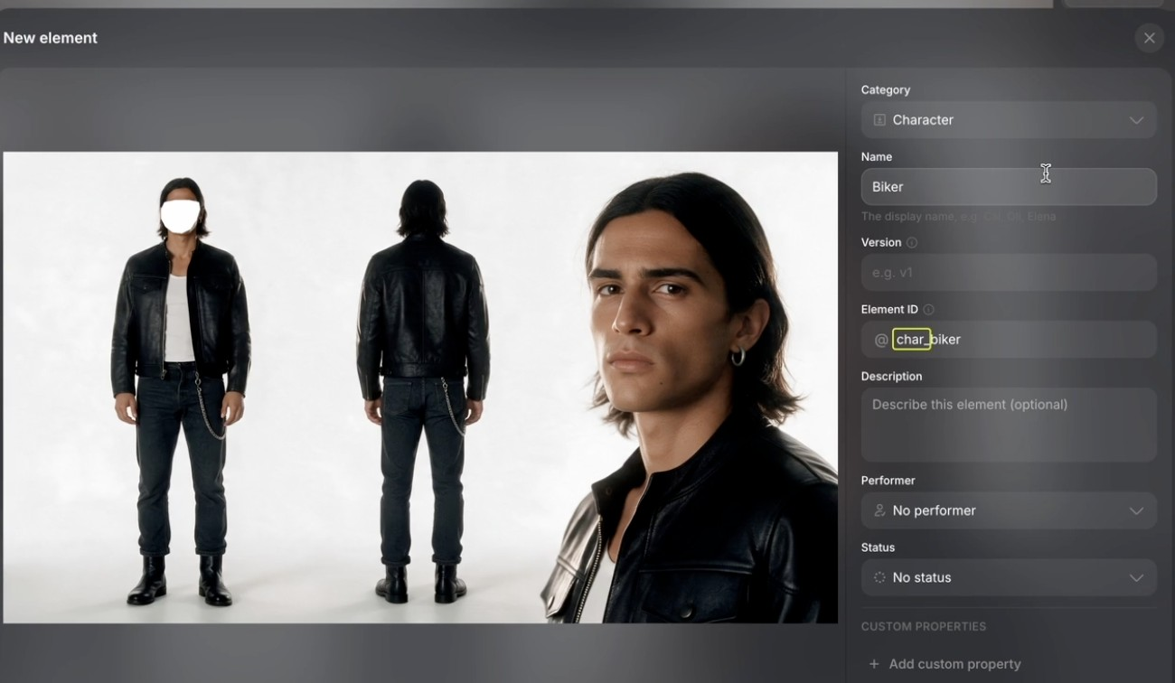
ELEMENTS · SAVE AS ELEMENT
Save once, reuse by name
Naming rule: char_, loc_, prop_ + a short slug, so the whole crew finds it
@char_biker in every prompt
One saved Element, one reference attached automatically, prompt after prompt.
The Element form
Category (Character, Location, Prop), Name, Element ID such as char_biker, description and custom properties.
© Tertiary Infotech Academy Pte Ltd
Creating Engaging Videos with Generative AI (GenAI) · TGS-2024043855
78

Slide 79
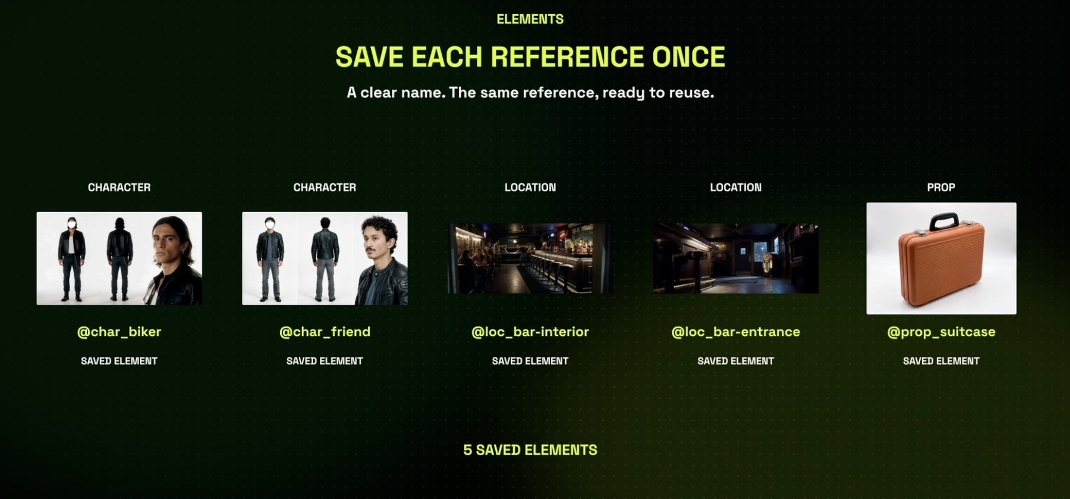
ELEMENTS · THE FINISH LINE
Five saved Elements: your cast, sets and props
What your My elements page should show at the end of the Elements lab
Characters
@char_biker, @char_friend
Locations
@loc_bar-interior, @loc_bar-entrance
Prop
@prop_suitcase, ready for every shot
© Tertiary Infotech Academy Pte Ltd
Creating Engaging Videos with Generative AI (GenAI) · TGS-2024043855
79

Slide 80
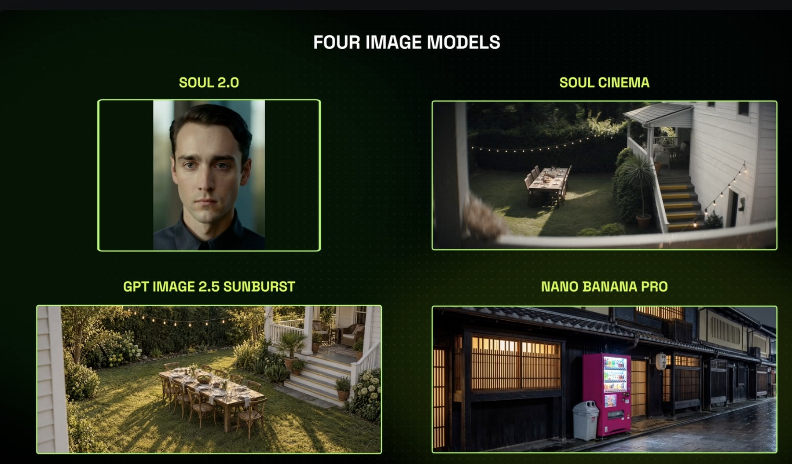
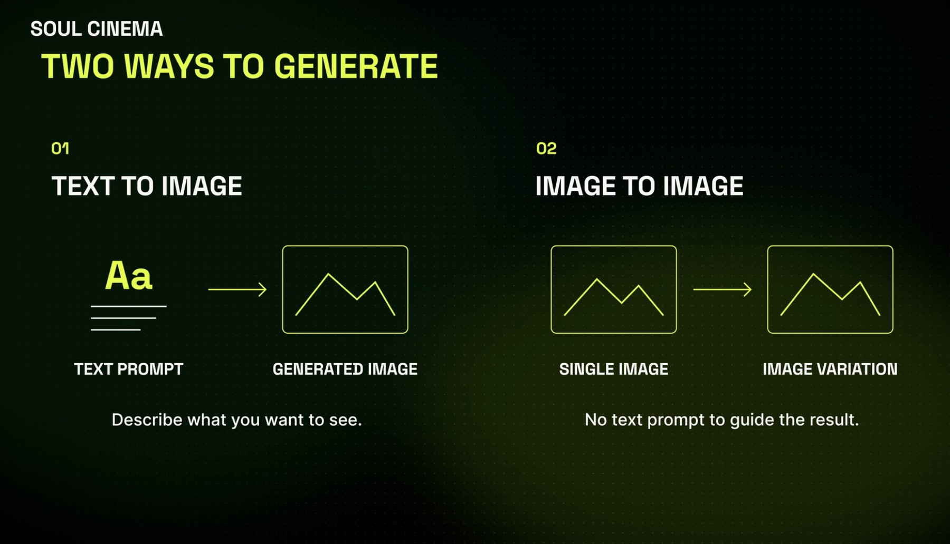
IMAGES · MODELS AND MODES
Pick the image model for the job
Elements start as images, so the image model decides the look of your film
Four image models
Soul 2.0 for people, Soul Cinema for film stills, GPT Image Sunburst for scenes, Nano Banana Pro for detailed places.
Two ways to generate
Text to image from a prompt, or image to image from a single picture to make variations.
© Tertiary Infotech Academy Pte Ltd
Creating Engaging Videos with Generative AI (GenAI) · TGS-2024043855
80

Slide 81
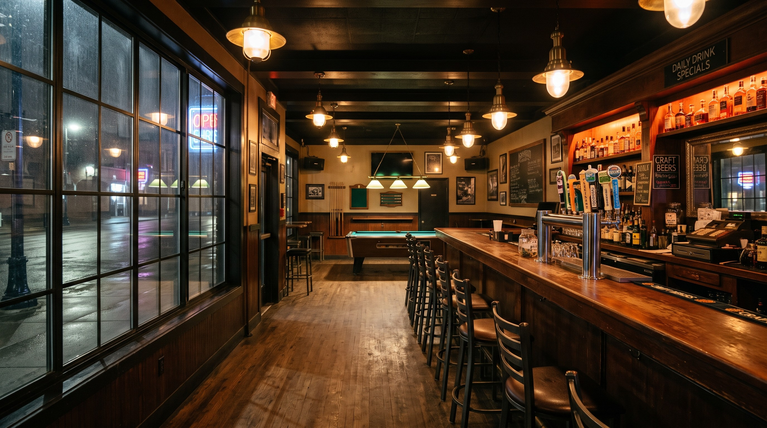

LAB 4 PREVIEW · TESTED IN HIGGSFIELD
Tested for this course: the Elements prompts work as written
Name what the shot must contain and the image model delivers it
Location prompt → the bar
Counter on the right, eight stools, pool table at the back, window on the left: every spatial anchor the prompt named. About 2 credits.
Prop prompt → the case
Slim orange ribbed lid, black handle, two metal latches, white background, no logos. About 2 credits.
© Tertiary Infotech Academy Pte Ltd
Creating Engaging Videos with Generative AI (GenAI) · TGS-2024043855
81
Notes:
Generated 9 Nov 2026 with the exact Lab 4 prompts. The same images ship in labs/lab-04…/assets as samples.

Slide 82
TOPIC 02 · HANDS-ON
Build Your Elements: Characters, Locations and Props
LAB 4
MAPS TO K2 — solutions that rectify quality issues (consistency); A4 — review footage for improvement
Faces that change between shots are the commonest AI video defect. Fix it before you shoot: cast a character with Supercomputer, turn the pick into a reference sheet, build a location and a prop, and save each one as an Element with an @handle you can call in any prompt.
You'll build
Five saved Elements, two characters, two locations and one prop, each with a reference image and an @handle.
Tools: Higgsfield: Supercomputer (character-sheet skill), Soul 2.0, Seedream 5.0 Pro, Nano Banana Pro, Elements
© Tertiary Infotech Academy Pte Ltd
Creating Engaging Videos with Generative AI (GenAI) · TGS-2024043855
82

Slide 83
LAB 4 · HOW IT RUNS — FULL STEPS IN THE LEARNER GUIDE
How Lab 4 Runs
1
2
3
4
5
Cast five options
Pick and build a sheet
Edit one detail
Build location + prop
Save as @Elements
© Tertiary Infotech Academy Pte Ltd
Creating Engaging Videos with Generative AI (GenAI) · TGS-2024043855
83

Slide 84
LAB 4 · COPY-AND-ADAPT PROMPTS
Lab 4 — Prompts (1/2)
PROMPT — CAST A CHARACTER (SUPERCOMPUTER)
Main character in a biker road movie, 25 years old, modern style clothing.
Use the character-sheet skill. Show me five photoreal casting options first; I will pick one before you build the reference sheet.
PROMPT — EDIT ONE DETAIL, KEEP IT CONSISTENT
Give him a silver wallet chain hanging off his jeans pocket. Replace the black t-shirt with a plain white ribbed cotton tank top, same tank top in all views.
© Tertiary Infotech Academy Pte Ltd
Creating Engaging Videos with Generative AI (GenAI) · TGS-2024043855
84

Slide 85
LAB 4 · COPY-AND-ADAPT PROMPTS
Lab 4 — Prompts (2/2)
PROMPT — LOCATION WITH SPATIAL ANCHORS
Wide interior of a dim neighbourhood bar at night: long wooden counter on the right with eight black stools, beer taps and backlit bottles, a pool table at the back, warm practical lamps, one large window on the left wall. Photoreal, 16:9, no people.
PROMPT — PROP (RUN ON TWO MODELS)
A slim orange hard-shell briefcase with a ribbed moulded lid, rounded corners, a black top handle and two metal latches, white background, soft studio light, no logos or text.
© Tertiary Infotech Academy Pte Ltd
Creating Engaging Videos with Generative AI (GenAI) · TGS-2024043855
85

Slide 86
LAB 4 · VERIFY
Build Your Elements: Characters, Locations and Props
✓ Check your work
Five Elements are saved with char_/loc_/prop_ handles; the character sheet shows the same face and outfit in all three views; each Element has a line saying which quality issue it prevents.
Detailed step-by-step instructions: Learner Guide + the lab folder in labs/.
© Tertiary Infotech Academy Pte Ltd
Creating Engaging Videos with Generative AI (GenAI) · TGS-2024043855
86

Slide 87
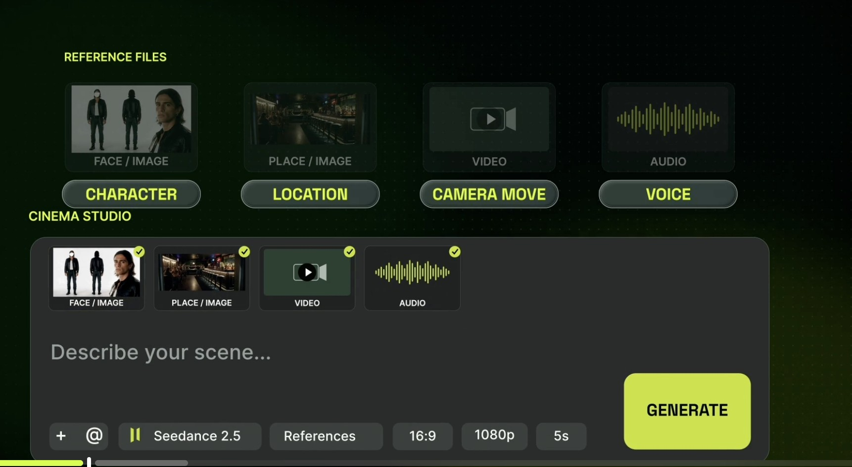
REFERENCES · ROLES
Each reference gets a job: character, location, camera, voice
A reference without a role is a suggestion; with a role it is an instruction
Face / image → Character
Who appears, exactly as shown.
Place / image → Location · video → Camera move
Where it happens, and how the camera travels.
Audio → Voice
What the character sounds like.
© Tertiary Infotech Academy Pte Ltd
Creating Engaging Videos with Generative AI (GenAI) · TGS-2024043855
87

Slide 88
REFERENCES · SEEDANCE 2.5 LIMITS
Up to fifty references in one generation
More references, fewer guesses
30
10
10
images
faces, outfits, products, places
videos
camera moves and motion to copy
audio files
voices, music, sound to match
What each image carries: a person = face + clothes; a prop = shape + colour + details; a place = space + light + colour.
© Tertiary Infotech Academy Pte Ltd
Creating Engaging Videos with Generative AI (GenAI) · TGS-2024043855
88

Slide 89
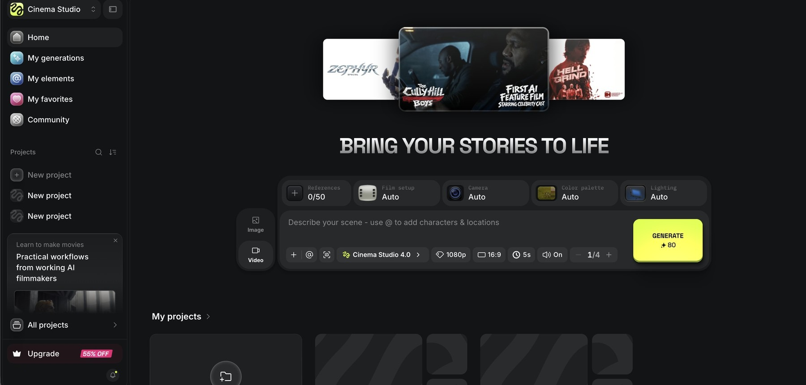
CINEMA STUDIO · THE PANEL
Cinema Studio: every control a film crew has
Set the look once, then every take inherits it
1
2
3
4
5
1
References 0/50
2
Film setup · Camera
3
Colour palette · Lighting
4
Describe your scene
5
Model and settings
Attach Elements, images, video and audio.
Camera body, lens and aperture.
The grade and the light scheme.
Type @ to drop in a saved character or location.
Cinema Studio 4.0, 1080p, 16:9, 5 s, sound, 1–4 takes; 80 credits.
© Tertiary Infotech Academy Pte Ltd
Creating Engaging Videos with Generative AI (GenAI) · TGS-2024043855
89

Slide 90
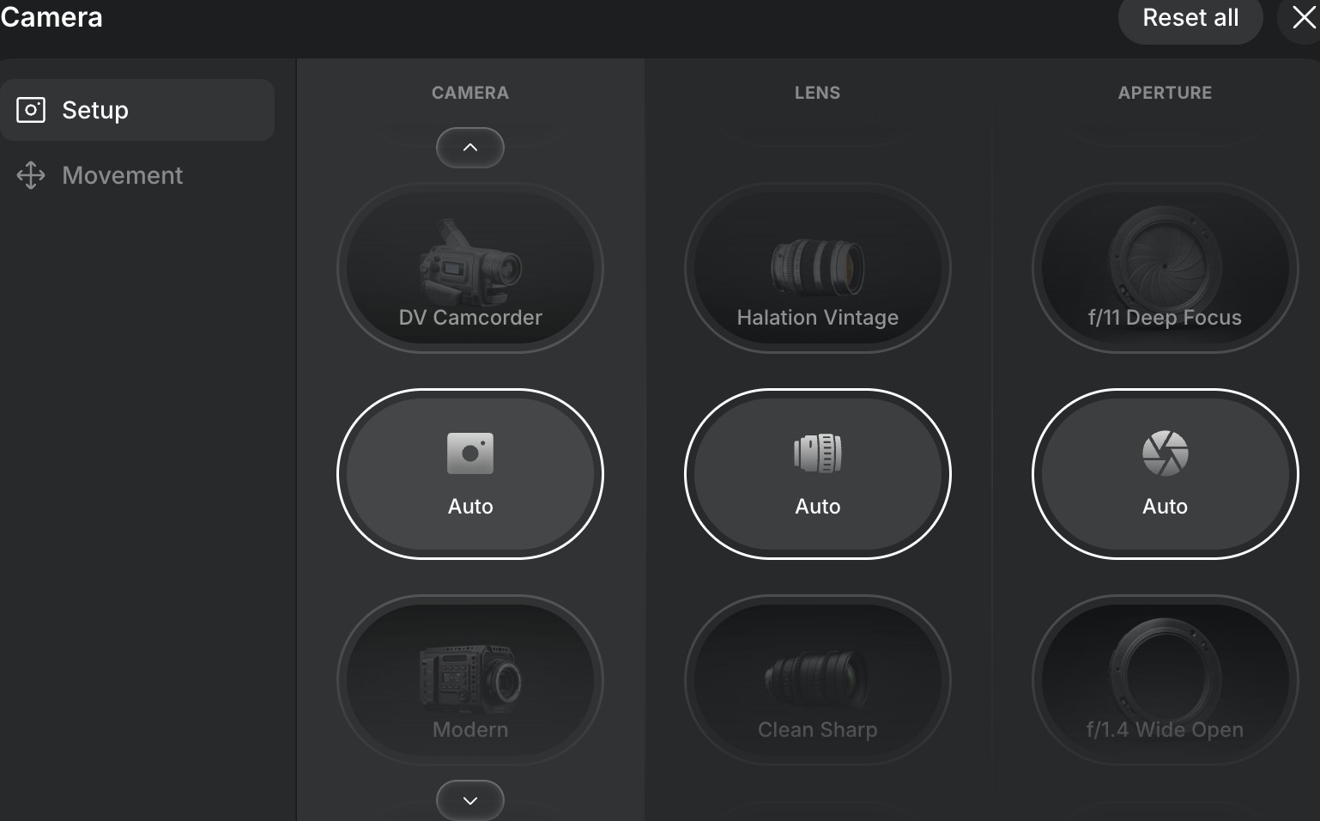
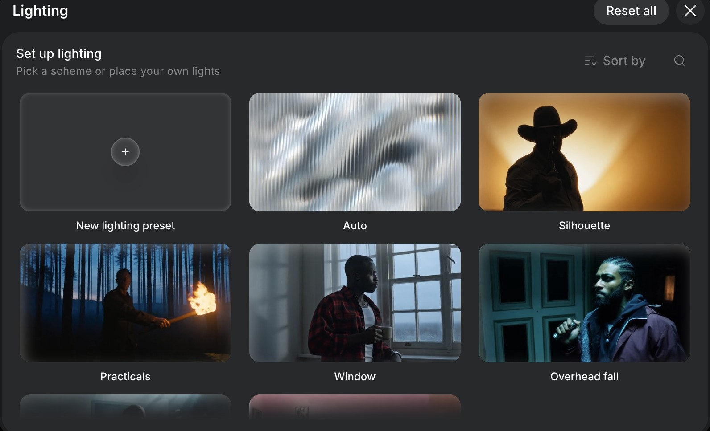
CINEMATIC EFFECTS · CAMERA + LIGHT
Set the camera and the light like a DP
Shallow focus and practical lamps make the bar feel real at night
Camera, lens, aperture, movement
DV Camcorder to Modern; Halation Vintage to Clean Sharp; f/11 deep focus to f/1.4 wide open.
Lighting presets
Auto, Silhouette, Practicals, Window, Overhead fall, or place your own lights.
© Tertiary Infotech Academy Pte Ltd
Creating Engaging Videos with Generative AI (GenAI) · TGS-2024043855
90

Slide 91
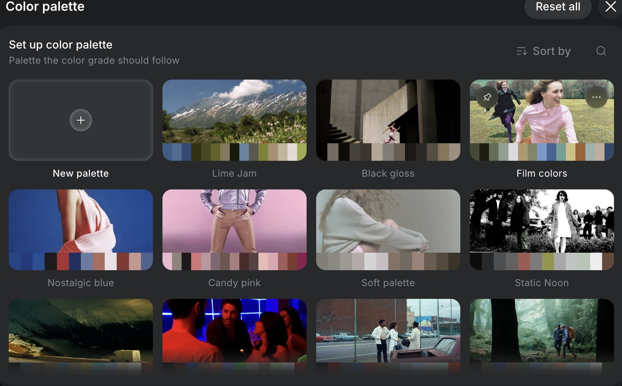
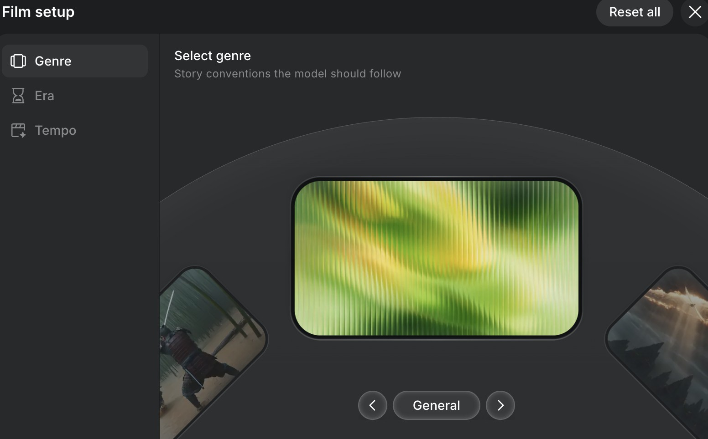
CINEMATIC EFFECTS · COLOUR + GENRE
Grade the colour and set the genre
A grade and a genre tell the model the mood in two clicks
Colour palette
Lime Jam, Black gloss, Film colors, Nostalgic blue, Candy pink, Soft palette, Static Noon, or build your own.
Genre, era, tempo
The story conventions the model should follow, the period, and the cutting pace.
© Tertiary Infotech Academy Pte Ltd
Creating Engaging Videos with Generative AI (GenAI) · TGS-2024043855
91

Slide 92
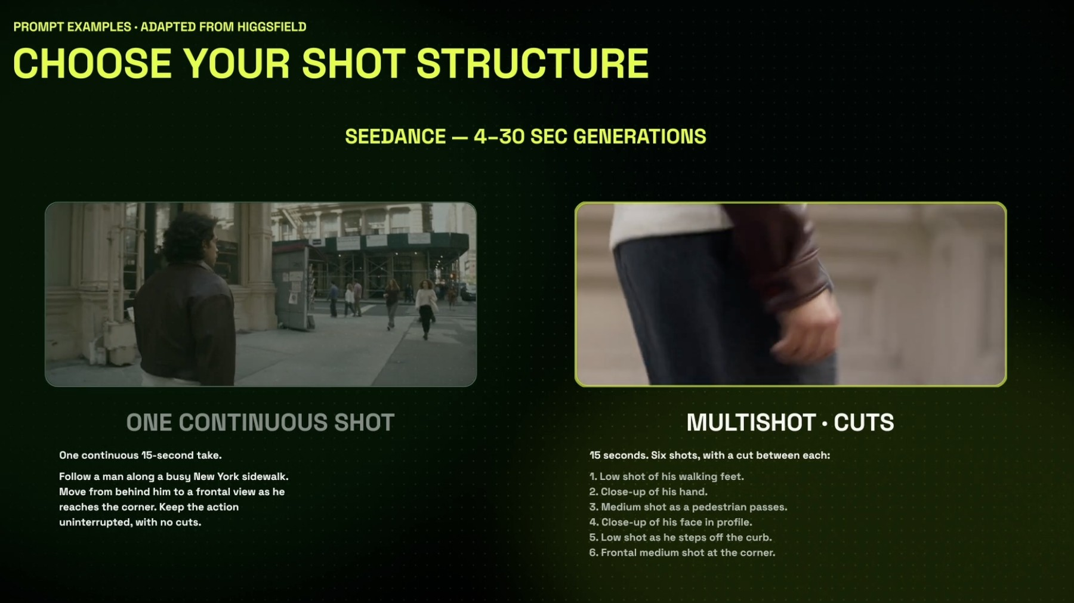
SHOTS · STRUCTURE
One continuous shot or a multishot with cuts
Decide the structure before the words: it changes every line you write
One continuous shot
'Follow a man along a busy sidewalk… frontal view at the corner… no cuts.' Good for immersion.
Multishot · cuts
'15 seconds, six shots, a cut between each': feet, hand, pedestrian pass, profile, kerb, corner.
Seedance range
4–30 seconds per generation; you choose the structure in the prompt.
© Tertiary Infotech Academy Pte Ltd
Creating Engaging Videos with Generative AI (GenAI) · TGS-2024043855
92

Slide 93
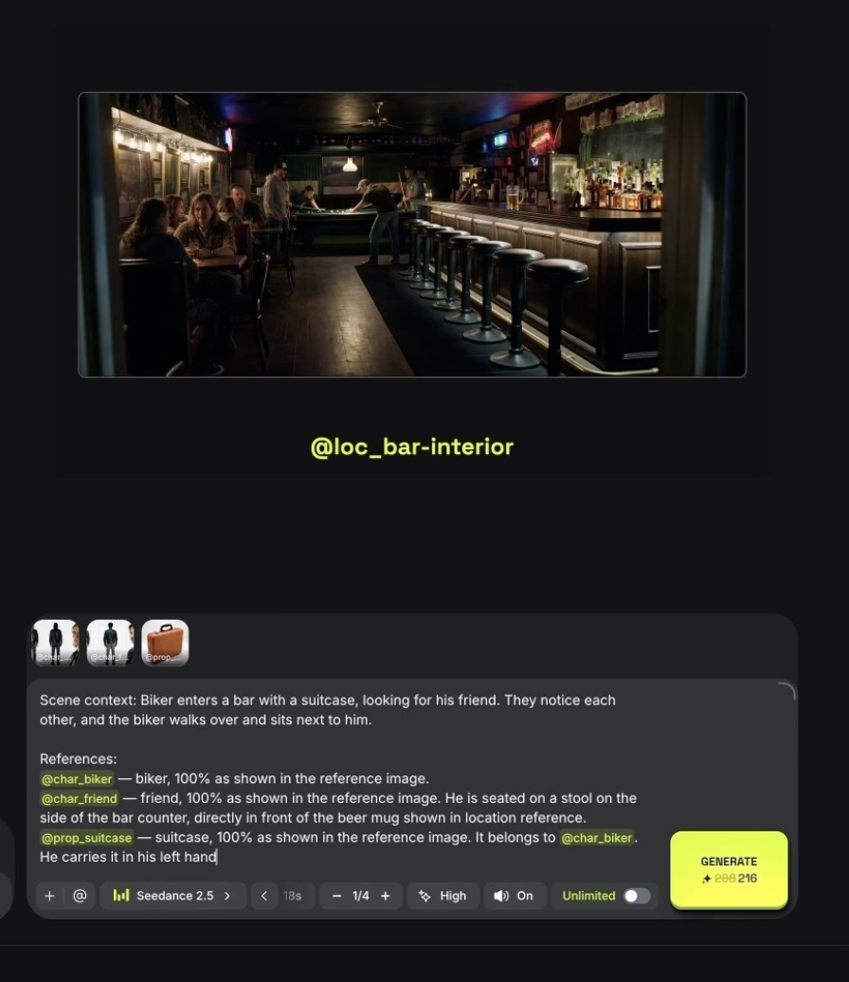
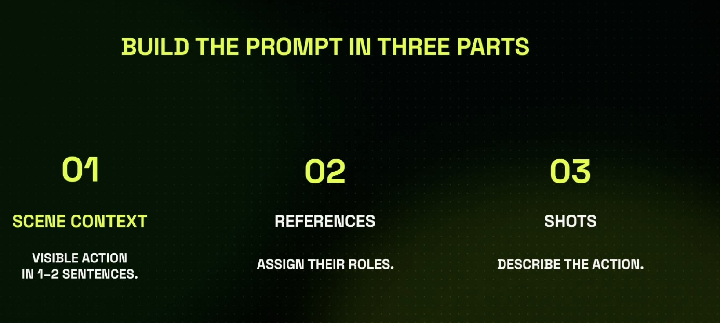
SHOTS · THE PROMPT
Write the three parts, then attach the references
Lab 5 gives you this exact bar-scene prompt to adapt
Context, references, shots
01 scene context in 1–2 sentences; 02 references and their roles; 03 the shots that describe the action.
A real prompt with @handles
@char_biker, @char_friend and @prop_suitcase each '100% as shown', with who holds what and where they sit.
© Tertiary Infotech Academy Pte Ltd
Creating Engaging Videos with Generative AI (GenAI) · TGS-2024043855
93

Slide 94
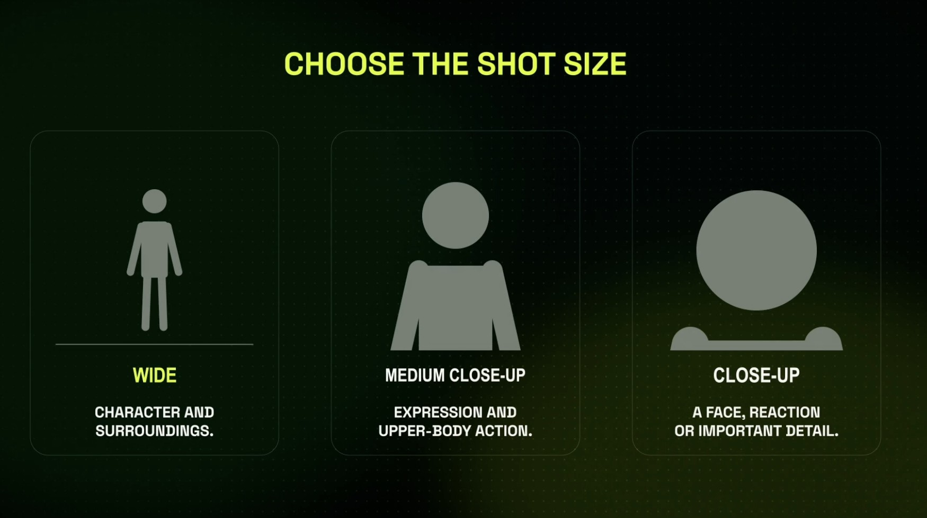
SHOTS · SIZE
Choose the shot size for what the audience must read
Every numbered shot in your prompt starts with one of these three words
Wide
Character and surroundings: where are we?
Medium close-up
Expression and upper-body action: what are they doing?
Close-up
A face, a reaction or an important detail: what do they feel?
© Tertiary Infotech Academy Pte Ltd
Creating Engaging Videos with Generative AI (GenAI) · TGS-2024043855
94

Slide 95
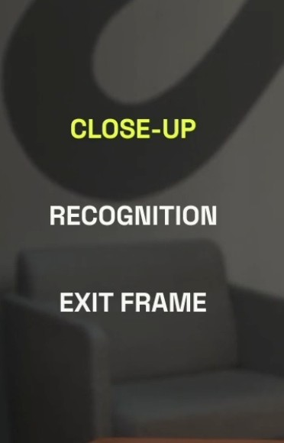
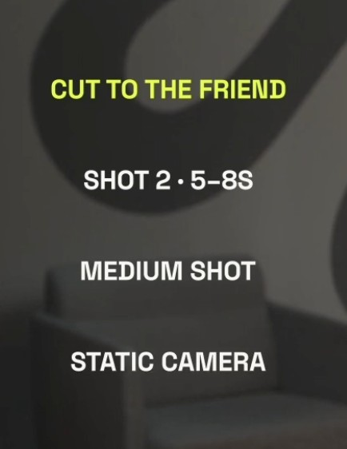
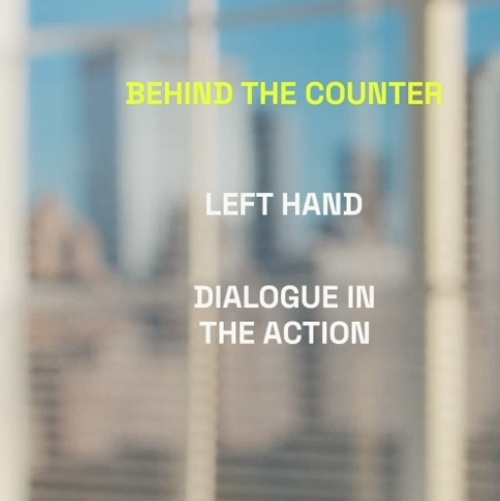
SHOTS · ANNOTATED
Write each shot as size + purpose + camera
Three shot cards from the bar scene: copy the pattern into your shot list
CLOSE-UP · recognition, exit frame
CUT TO THE FRIEND · shot 2, 5–8 s, medium, static
BEHIND THE COUNTER · left hand, dialogue in the action
Pattern: SHOT n · time · size · camera · action · the line or sound that lands in it.
© Tertiary Infotech Academy Pte Ltd
Creating Engaging Videos with Generative AI (GenAI) · TGS-2024043855
95

Slide 96
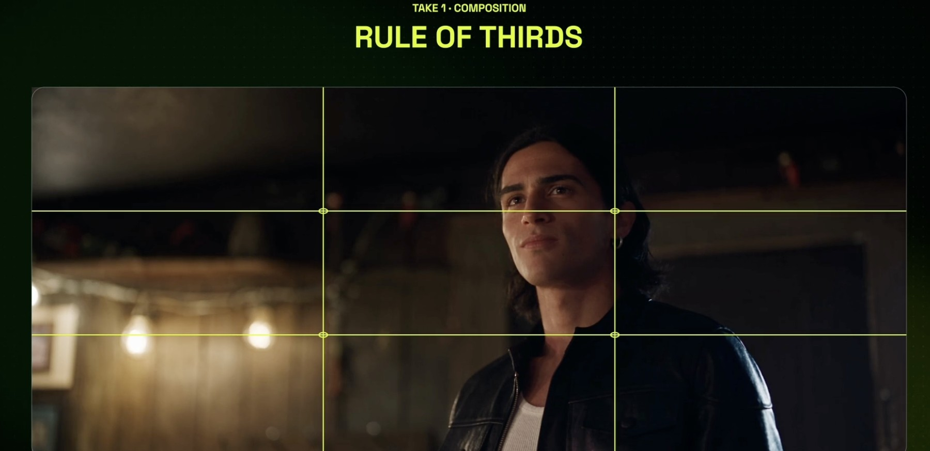
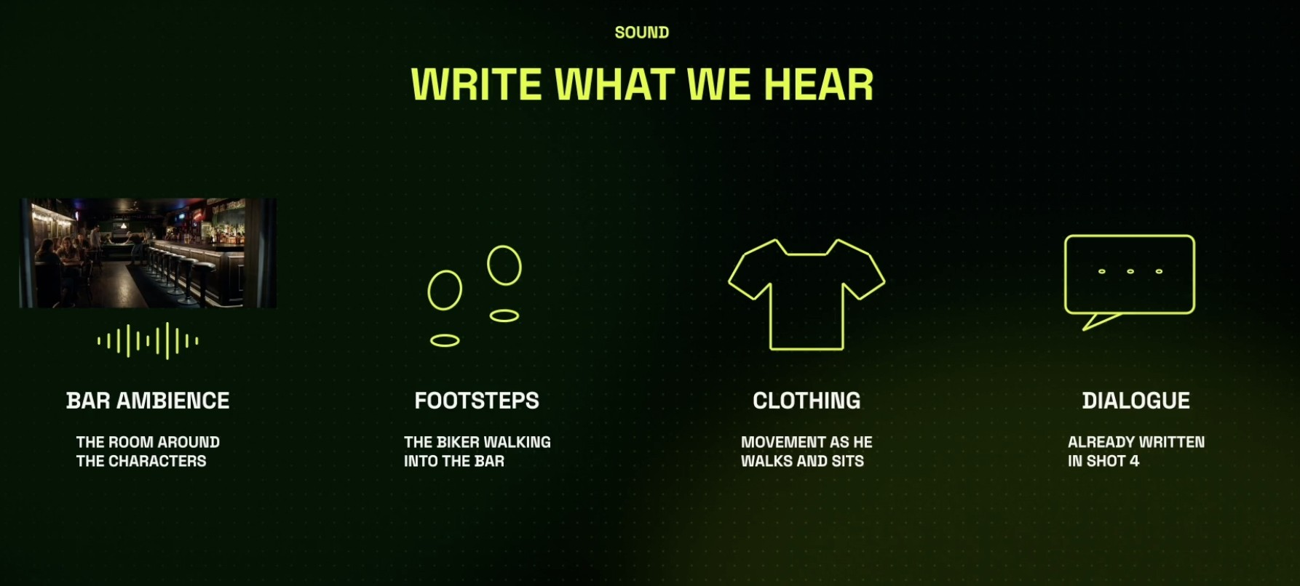
TAKES · COMPOSITION AND SOUND
Compose the frame, then write what we hear
Two lines in the prompt that separate a clip from a scene
Rule of thirds
Eyes on the upper third, the subject off-centre, space in the direction he looks.
Sound is part of the prompt
Bar ambience, footsteps, clothing movement, dialogue already written in shot 4. Seedance renders it with the picture.
© Tertiary Infotech Academy Pte Ltd
Creating Engaging Videos with Generative AI (GenAI) · TGS-2024043855
96

Slide 97
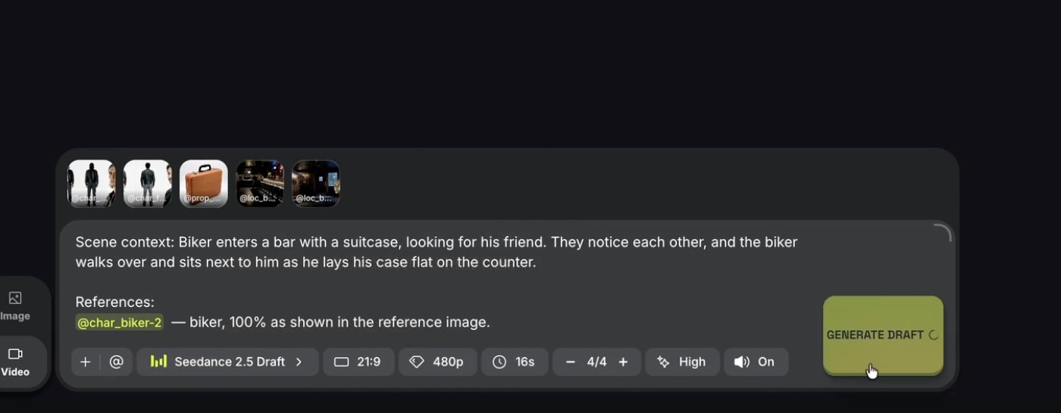
SHOTS & TAKES · DRAFT MODE
Draft mode: four test takes for the price of one final
Explore at 480p, commit at 1080p
1
2
4
3
1
References attached
2
Three-part prompt
3
Seedance 2.5 Draft
4
Generate Draft
Characters, prop and both bar locations.
Scene context, references with roles, shots.
480p, 21:9, 16 s, 4 takes, sound on.
About 45 credits a take for 15 s; review before you spend more.
© Tertiary Infotech Academy Pte Ltd
Creating Engaging Videos with Generative AI (GenAI) · TGS-2024043855
97

Slide 98
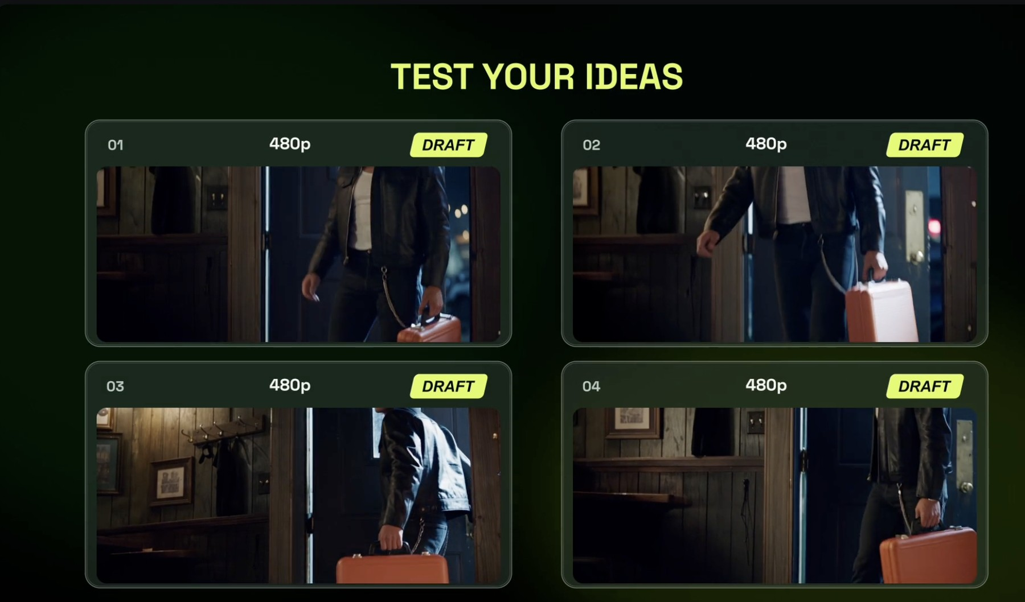
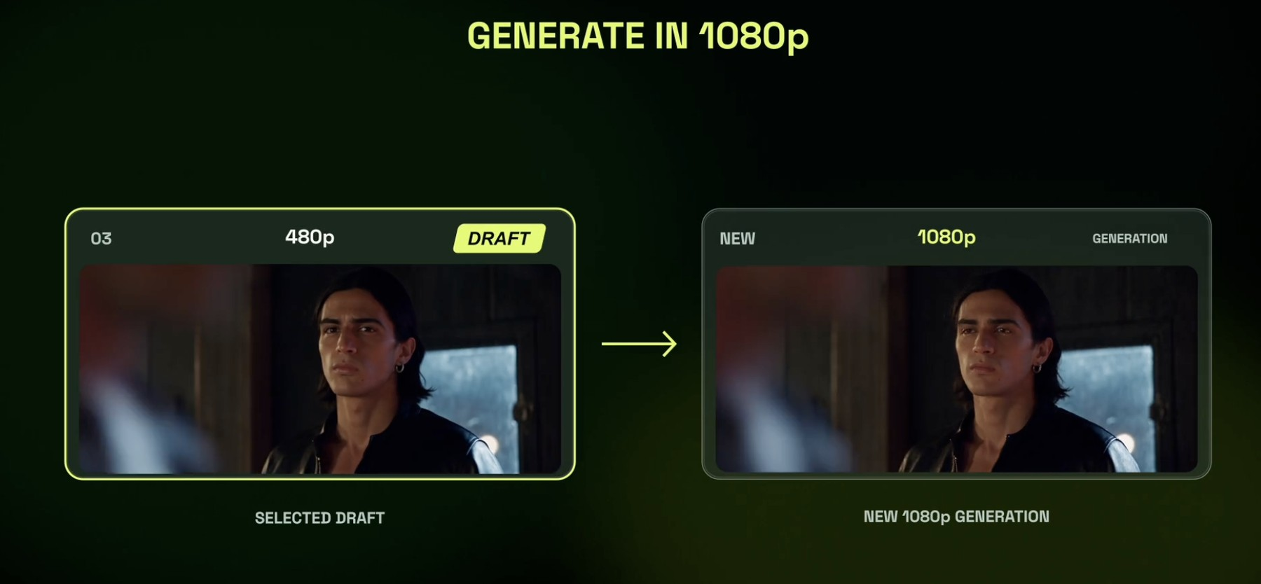
SHOTS & TAKES · DRAFT → FINAL
Test four ideas, finalise one
Drafts can be finalised within seven days
Four 480p Drafts
Same prompt, four takes. Compare the walk, the case and the light.
Generate the keeper in 1080p
The selected Draft is re-rendered at full resolution: same take, full quality.
© Tertiary Infotech Academy Pte Ltd
Creating Engaging Videos with Generative AI (GenAI) · TGS-2024043855
98

Slide 99
TOPIC 02 · HANDS-ON
Direct Shots and Takes in Cinema Studio
LAB 5
MAPS TO A4 — review footage to improve storytelling; K2 — solutions to rectify quality issues
Direct a 15-second bar scene the way a film crew would: attach your Elements as references with roles, set camera, lens, lighting and colour, write the shots and the sound, then render four 480p Draft takes. Finalise only the best take in 1080p.
You'll build
Four Draft takes of one scene and one 1080p final of the best take, made from your Elements.
Tools: Higgsfield: Cinema Studio, Seedance 2.5 / Seedance 2.5 Draft, References, Elements
© Tertiary Infotech Academy Pte Ltd
Creating Engaging Videos with Generative AI (GenAI) · TGS-2024043855
99

Slide 100
LAB 5 · HOW IT RUNS — FULL STEPS IN THE LEARNER GUIDE
How Lab 5 Runs
1
2
3
4
5
Attach references with roles
Set camera, light, colour
Write context, shots, sound
Render 4 Draft takes
Finalise the best in 1080p
© Tertiary Infotech Academy Pte Ltd
Creating Engaging Videos with Generative AI (GenAI) · TGS-2024043855
100

Slide 101
LAB 5 · COPY-AND-ADAPT PROMPTS
Lab 5 — Prompts (1/2)
PROMPT — BAR SCENE — THREE-PART PROMPT (SEEDANCE 2.5)
Scene context: Biker enters a bar with a suitcase, looking for his friend. They notice each other, and the biker walks over and sits next to him as he lays his case flat on the counter.
References:
@char_biker — biker, 100% as shown in the reference image.
@char_friend — friend, 100% as shown in the reference image. He is seated on a stool on the side of the bar counter.
@prop_suitcase — suitcase, 100% as shown in the reference image. It belongs to @char_biker. He carries it in his left hand.
@loc_bar-interior — the bar, 100% as shown in the location reference.
Shots (cut between each):
1. 0–3s: wide, the biker pushes through the door, suitcase in his left hand.
2. 3–6s: medium shot, the friend looks up from his beer. Static camera.
3. 6–9s: close-up, the biker recognises him.
4. 9–12s: medium close-up, the biker sits; dialogue: "Told you I'd make it."
5. 12–15s: close-up, he lays the case flat on the counter.
Sound: bar ambience, footsteps, leather jacket movement, the line of dialogue.
© Tertiary Infotech Academy Pte Ltd
Creating Engaging Videos with Generative AI (GenAI) · TGS-2024043855
101

Slide 102
LAB 5 · COPY-AND-ADAPT PROMPTS
Lab 5 — Prompts (2/2)
PROMPT — ONE CONTINUOUS SHOT (COMPARE)
One continuous 15-second take. Follow a man along a busy New York sidewalk. Move from behind him to a frontal view as he reaches the corner. Keep the action uninterrupted, with no cuts.
© Tertiary Infotech Academy Pte Ltd
Creating Engaging Videos with Generative AI (GenAI) · TGS-2024043855
102

Slide 103
LAB 5 · VERIFY
Direct Shots and Takes in Cinema Studio
✓ Check your work
All four Drafts use your Elements; your take log scores each take; the 1080p final is the take you scored best and keeps the same faces, prop and bar.
Detailed step-by-step instructions: Learner Guide + the lab folder in labs/.
© Tertiary Infotech Academy Pte Ltd
Creating Engaging Videos with Generative AI (GenAI) · TGS-2024043855
103

Slide 104
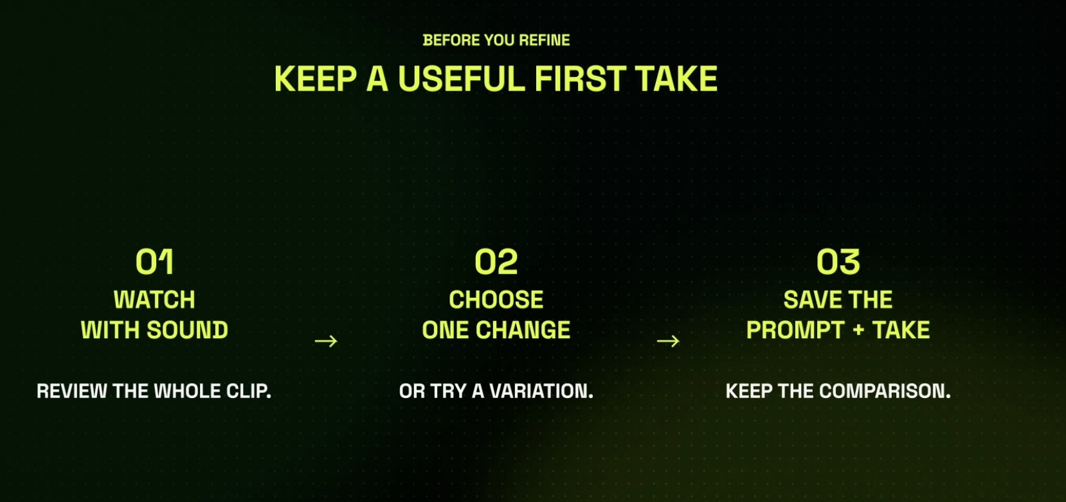

TAKES · THE DIRECTOR'S LOOP
Keep a useful first take, then direct the next one
A take is a decision you can undo; a deleted take is a lesson lost
Before you refine
Watch with sound, choose ONE change or a variation, save the prompt and the take so you can compare.
Direct the next take
Change one instruction, generate one take, compare, choose. Keep both prompts and clips.
© Tertiary Infotech Academy Pte Ltd
Creating Engaging Videos with Generative AI (GenAI) · TGS-2024043855
104

Slide 105

A5 · ASSESS THE FOOTAGE
Continuity: check the prop through the whole scene
Prop teleport is the defect viewers spot first
Where?
Its position in each shot.
Who holds it?
The right character, the right hand.
Same?
Colour, shape and size from shot to shot.
© Tertiary Infotech Academy Pte Ltd
Creating Engaging Videos with Generative AI (GenAI) · TGS-2024043855
105

Slide 106
K1 → K2 · THE WA ASKS EXACTLY THIS
Quality issues → the Higgsfield fix
Issue (K1)
Typical cause
Fix in Higgsfield (K2)
Face changes between shots
No character reference
Character Element + sheet
Set changes between shots
No location reference
Location Element with anchors
Prop swaps hands or vanishes
Holder not stated
'@prop… belongs to @char…, left hand'
Wrong object in the shot
Model guessed
Genjutsu Replace Object
Soft, low-res final
480p Draft exported
Finalise at 1080p or Upscale
Wrong ratio for TikTok
16:9 master only
Reframe to 9:16
TIP: Every issue on the left appears in the Written Assessment: know the matching fix.
© Tertiary Infotech Academy Pte Ltd
Creating Engaging Videos with Generative AI (GenAI) · TGS-2024043855
106

Slide 107
K3 · SCORE EVERY CUT BEFORE EXPORT
Parameters to assess AI video quality (K3)
Resolution & sharpness
1080p minimum for social; no 480p Draft in the final.
Motion & physics
No melting hands, sliding feet or stutter at cuts.
1
2
Continuity
Faces, clothes, props and sets match shot to shot.
Audio
Dialogue clear above music; foley matches the action.
3
4
Captions & pacing
Accurate, in sync, readable; cuts on the beat.
Compliance
Platform specs, AI label, consent, rights.
5
6
© Tertiary Infotech Academy Pte Ltd
Creating Engaging Videos with Generative AI (GenAI) · TGS-2024043855
107

Slide 108
TOPIC 02 · HANDS-ON
Cut, Caption and Assess the Scene
LAB 6
MAPS TO A4 — review edited footage to improve storytelling; A5 — assess footage against technical and legal requirements; K3 — quality parameters
Keep the useful first take, direct one more, then have Supercomputer assemble the takes into a captioned cut with a soundtrack. Score the cut against the quality parameters and your Lab 3 standards before anything is exported.
You'll build
A captioned 15–30 s cut in 16:9 and 9:16 with a scored quality checklist and a list of storytelling improvements.
Tools: Higgsfield: Cinema Studio, Supercomputer (video montage: trims, soundtrack, burned captions)
© Tertiary Infotech Academy Pte Ltd
Creating Engaging Videos with Generative AI (GenAI) · TGS-2024043855
108

Slide 109
LAB 6 · HOW IT RUNS — FULL STEPS IN THE LEARNER GUIDE
How Lab 6 Runs
1
2
3
4
5
Keep a useful first take
Direct one change
Continuity check
Assemble, caption, soundtrack
Score against the checklist
© Tertiary Infotech Academy Pte Ltd
Creating Engaging Videos with Generative AI (GenAI) · TGS-2024043855
109

Slide 110
LAB 6 · COPY-AND-ADAPT PROMPTS
Lab 6 — Prompts
PROMPT — DIRECT ONE CHANGE
Keep everything in this take the same. Change one thing only: in shot 3 make the camera push in slowly on the biker's face as he recognises his friend, and add a beat of silence before the dialogue.
PROMPT — ASSEMBLE, CAPTION AND SCORE (SUPERCOMPUTER)
Assemble these two clips into one 20-second cut: take 2 first, then shots 4–5 of take 1. Trim dead frames at each cut.
Add a moody low-tempo soundtrack under the bar ambience, keep the dialogue clearly above the music.
Burn captions for the dialogue: white, bottom third, two lines max. Export 16:9 and 9:16.
Then score the cut against: resolution, motion, face/prop continuity, audio, captions, pacing, platform compliance. Table, pass/fail.
© Tertiary Infotech Academy Pte Ltd
Creating Engaging Videos with Generative AI (GenAI) · TGS-2024043855
110

Slide 111
LAB 6 · VERIFY
Cut, Caption and Assess the Scene
✓ Check your work
The checklist scores every parameter with a reason, the cut exports in both ratios with readable captions, and you name three storytelling improvements tied to specific shots.
Detailed step-by-step instructions: Learner Guide + the lab folder in labs/.
© Tertiary Infotech Academy Pte Ltd
Creating Engaging Videos with Generative AI (GenAI) · TGS-2024043855
111

Slide 112
TOPIC RECAP · WHAT YOU CAN NOW DO
Recap — Improve Video Footage on GenAI-Powered Video Platforms
Lab 4 — Build Your Elements: Characters, Locations and Props
You built: Five saved Elements, two characters, two locations and one prop, each with a reference image and an @handle.
4
Lab 5 — Direct Shots and Takes in Cinema Studio
You built: Four Draft takes of one scene and one 1080p final of the best take, made from your Elements.
5
Lab 6 — Cut, Caption and Assess the Scene
You built: A captioned 15–30 s cut in 16:9 and 9:16 with a scored quality checklist and a list of storytelling improvements.
6
© Tertiary Infotech Academy Pte Ltd
Creating Engaging Videos with Generative AI (GenAI) · TGS-2024043855
112

Slide 113
TOPIC 3
1
Lab 7 — Fix What Fails: Remedial Actions in Higgsfield
Apply New AI Technologies to Improve Video Production
2
Lab 8 — Add Voice, Music and Cinematic Effects
3
Lab 9 — Use-Case Sprint: One Product Photo to a Published 15-Second Ad
Remove & replace objects · cinematic effects · upscale · voice & music · models compared · publish
© Tertiary Infotech Academy Pte Ltd
Creating Engaging Videos with Generative AI (GenAI) · TGS-2024043855
113

Slide 114
COVERS K4 · K5 · A6 · A7
Key Concepts — Topic 3
Remove & replace
Genjutsu Replace Object swaps a product, prop or garment in finished footage, keeping the motion.
Cinematic effects
Lighting presets, colour grades and viral effect presets add VFX without a compositor.
1
2
Enhance shots
Upscale to 1080p or 4K, reframe 16:9 to 9:16, regenerate only the broken shot.
Voice & music
Native Seedance audio, a cloned voice for narration and a generated soundtrack.
3
4
Models compared
Seedance 2.5, Kling 4.0, Cinema Studio 4.0 and Genjutsu: pick per shot on quality, cost and control.
Publish responsibly
Export per platform, label synthetic media, clear consent, then share to TikTok or YouTube.
5
6
© Tertiary Infotech Academy Pte Ltd
Creating Engaging Videos with Generative AI (GenAI) · TGS-2024043855
114

Slide 115
WHAT YOU'LL DO
Hands-On Labs — Topic 3
Lab 7 — Fix What Fails: Remedial Actions in Higgsfield
A remediated cut with a before/after checklist and a remedy table (issue, cause, Higgsfield fix, result).
7
Lab 8 — Add Voice, Music and Cinematic Effects
Your scene with a generated soundtrack, a voiceover line and one cinematic effect, plus a rated technology evaluation.
8
Lab 9 — Use-Case Sprint: One Product Photo to a Published 15-Second Ad
A 15-second ad (16:9 and 9:16) made from one product photo, a two-model comparison, and a publish-ready post.
9
© Tertiary Infotech Academy Pte Ltd
Creating Engaging Videos with Generative AI (GenAI) · TGS-2024043855
115

Slide 116
A6 · REMEDIAL ACTIONS
Remedial actions: from FAIL to fixed
Fails the check
Remedial action (A6)
Higgsfield tool
Wrong or drifting object
Swap it, keep the motion
Genjutsu Replace Object
One broken shot
Regenerate that shot only, same Elements
Cinema Studio
Soft or 480p footage
Upscale or finalise the Draft
Upscale · Seedance 2.5
16:9 only, TikTok needs 9:16
Reframe with a safe area
Reframe
Muddy or wrong sound
Rewrite the Sound line, regenerate
Seedance native audio
No AI label / no consent
Add label, record consent
Publish settings
TIP: Order fixes cheapest first: a sound-line rewrite on Draft costs 45 credits; a full 1080p re-shoot costs 240.
© Tertiary Infotech Academy Pte Ltd
Creating Engaging Videos with Generative AI (GenAI) · TGS-2024043855
116

Slide 117

REMOVE OBJECTS FROM A SCENE
Remove or replace an object without re-shooting
For video, Genjutsu Replace Object does the same while keeping the motion
1
Attach the shot
2
Say what changes
3
Keep everything else
Drop the image or clip into Supercomputer.
'Remove the table and put the glasses on a plinth.'
Light, angle and the object itself stay as they were.
© Tertiary Infotech Academy Pte Ltd
Creating Engaging Videos with Generative AI (GenAI) · TGS-2024043855
117

Slide 118
COMPLY BEFORE YOU PUBLISH
Industry standards & responsible AI (K4)
Platform specs
Resolution, ratio, duration and loudness per platform.
Commercial rights
Check your Higgsfield plan covers client work.
1
2
Consent & PDPA
Permission for real faces and voices; clone only with consent.
AI disclosure
TikTok's AI-generated label; YouTube's altered or synthetic content setting.
3
4
Advertising codes
IMDA and ASAS rules apply to AI ads too.
Accuracy
No invented product claims; fact-check every line.
5
6
© Tertiary Infotech Academy Pte Ltd
Creating Engaging Videos with Generative AI (GenAI) · TGS-2024043855
118

Slide 119
TOPIC 03 · HANDS-ON
Fix What Fails: Remedial Actions in Higgsfield
LAB 7
MAPS TO A6 — develop remedial actions for footage that does not meet requirements; K4 — industry quality standards
Take every FAIL from your Lab 6 checklist and match it to a Higgsfield fix: replace the wrong object, upscale soft footage, reframe for vertical, or regenerate only the broken shot with the same Elements. Apply at least two fixes and re-score.
You'll build
A remediated cut with a before/after checklist and a remedy table (issue, cause, Higgsfield fix, result).
Tools: Higgsfield: Genjutsu Replace Object, Upscale, Reframe, Cinema Studio (regenerate a shot)
© Tertiary Infotech Academy Pte Ltd
Creating Engaging Videos with Generative AI (GenAI) · TGS-2024043855
119

Slide 120
LAB 7 · HOW IT RUNS — FULL STEPS IN THE LEARNER GUIDE
How Lab 7 Runs
1
2
3
4
5
List every FAIL
Match issue to fix
Apply two fixes (Draft first)
Re-score the cut
Compliance pass
© Tertiary Infotech Academy Pte Ltd
Creating Engaging Videos with Generative AI (GenAI) · TGS-2024043855
120

Slide 121
LAB 7 · COPY-AND-ADAPT PROMPTS
Lab 7 — Prompts (1/2)
PROMPT — DIAGNOSE THE CUT (SUPERCOMPUTER)
Here is my cut and my quality checklist. For every FAIL, give: the issue, the likely cause, the Higgsfield fix
(Replace Object, Upscale, Reframe, regenerate one shot with the same Elements, or a new Sound line) and the credit cost.
Order the fixes cheapest first. Table.
PROMPT — REPLACE AN OBJECT (GENJUTSU)
Replace the orange briefcase in this clip with the black hard-shell case in the reference image. Keep the hand position, motion, lighting and timing exactly the same.
© Tertiary Infotech Academy Pte Ltd
Creating Engaging Videos with Generative AI (GenAI) · TGS-2024043855
121

Slide 122
LAB 7 · COPY-AND-ADAPT PROMPTS
Lab 7 — Prompts (2/2)
PROMPT — REGENERATE ONE SHOT ONLY
Regenerate shot 3 only. Same Elements (@char_biker, @loc_bar-interior), same framing and timing. Fix: his face must match the reference sheet and the case stays in his left hand.
© Tertiary Infotech Academy Pte Ltd
Creating Engaging Videos with Generative AI (GenAI) · TGS-2024043855
122

Slide 123
LAB 7 · VERIFY
Fix What Fails: Remedial Actions in Higgsfield
✓ Check your work
At least two FAILs are fixed with named Higgsfield tools, the re-score shows them as PASS, and the remedy table states the cause and credit cost of each fix.
Detailed step-by-step instructions: Learner Guide + the lab folder in labs/.
© Tertiary Infotech Academy Pte Ltd
Creating Engaging Videos with Generative AI (GenAI) · TGS-2024043855
123

Slide 124
K5 · TECHNOLOGIES THAT SPEED UP THE EDIT
Voice, music and effects: three vendors become three prompts
Native sound
Seedance 2.5 renders ambience, foley and dialogue with the picture.
Soundtrack
Higgsfield Audio composes a track from genre, tempo and mood.
1
2
Your voice
Create Voice from a clean sample: only with consent.
Cinematic effects
Lighting presets, colour grades and effect presets on any shot.
3
4
Enhance
Upscale to 1080p or 4K; reframe for vertical.
Publish
Connect TikTok and post from Higgsfield, or export MP4.
5
6
© Tertiary Infotech Academy Pte Ltd
Creating Engaging Videos with Generative AI (GenAI) · TGS-2024043855
124

Slide 125
A REPEATABLE EVALUATION RUBRIC
Evaluating a new AI technology (A7)
Criterion
Ask
Red flag
Quality
Does output meet your standards sheet?
Drift, artefacts, robotic voice
Speed & cost
Minutes and credits per finished 15 s?
Credits burn faster than value
Control
Can you direct and iterate the result?
Black box, no editing
Rights
Commercial use on your plan?
Licence excludes client work
Fit
Works inside your Higgsfield pipeline?
New silo, manual re-export
TIP: Labs 8 and 9 use this rubric: rate voice, music and effects, then two video models on the same prompt.
© Tertiary Infotech Academy Pte Ltd
Creating Engaging Videos with Generative AI (GenAI) · TGS-2024043855
125

Slide 126
TOPIC 03 · HANDS-ON
Add Voice, Music and Cinematic Effects
LAB 8
MAPS TO K5 — technologies that improve efficiency and quality; A7 — evaluate new technologies
Finish the scene with the three upgrades that used to need three vendors: a generated soundtrack, a voiceover in a cloned or stock voice, and a cinematic effect. Time each one and rate it on quality, cost and control.
You'll build
Your scene with a generated soundtrack, a voiceover line and one cinematic effect, plus a rated technology evaluation.
Tools: Higgsfield: Audio (music + voice), Create Voice, lighting and colour presets, effect presets
© Tertiary Infotech Academy Pte Ltd
Creating Engaging Videos with Generative AI (GenAI) · TGS-2024043855
126

Slide 127
LAB 8 · HOW IT RUNS — FULL STEPS IN THE LEARNER GUIDE
How Lab 8 Runs
1
2
3
4
5
Generate the soundtrack
Voiceover: clone or stock
Apply a cinematic effect
Time and cost each step
Rate each technology
© Tertiary Infotech Academy Pte Ltd
Creating Engaging Videos with Generative AI (GenAI) · TGS-2024043855
127

Slide 128
LAB 8 · COPY-AND-ADAPT PROMPTS
Lab 8 — Prompts (1/2)
PROMPT — SOUNDTRACK
Moody late-night bar soundtrack, 20 seconds, slow 80 BPM, warm Rhodes piano, soft brushed drums, upright bass, building slightly on the last 5 seconds. Instrumental, no vocals.
PROMPT — VOICEOVER LINE
Calm, low male voice, unhurried, Singapore English: "Some nights you don't need a plan. You just need to show up."
© Tertiary Infotech Academy Pte Ltd
Creating Engaging Videos with Generative AI (GenAI) · TGS-2024043855
128

Slide 129
LAB 8 · COPY-AND-ADAPT PROMPTS
Lab 8 — Prompts (2/2)
PROMPT — CINEMATIC EFFECT RE-RUN
Same shot, same Elements. Lighting: silhouette against the window, city lights behind. Colour: Black gloss. Slow push-in. Keep timing and action identical.
© Tertiary Infotech Academy Pte Ltd
Creating Engaging Videos with Generative AI (GenAI) · TGS-2024043855
129

Slide 130
LAB 8 · VERIFY
Add Voice, Music and Cinematic Effects
✓ Check your work
The scene carries a generated soundtrack and a consented voiceover, one shot shows a clear cinematic effect, and every technology has a 1–5 rating with a keep/drop verdict.
Detailed step-by-step instructions: Learner Guide + the lab folder in labs/.
© Tertiary Infotech Academy Pte Ltd
Creating Engaging Videos with Generative AI (GenAI) · TGS-2024043855
130

Slide 131

AI MARKETING · PRODUCT REFERENCE
Start every product video from a clean product reference
The model can only keep what it can see
Full object
The whole product in frame, nothing cropped.
Clear light
Even light, no hard shadows hiding the shape.
Visible edges
A plain background so the outline is unmistakable.
© Tertiary Infotech Academy Pte Ltd
Creating Engaging Videos with Generative AI (GenAI) · TGS-2024043855
131

Slide 132


AI MARKETING · PRODUCT FIDELITY
Check the product survives generation
Approve the product in stills before you spend on video
Original vs generated
Compare the outline, the bridge and the frame. If a detail changed in a still, it will change in video.
One photo becomes a campaign
Photo shoot, creator video and commercial, all from one product photo plus a character and a location.
© Tertiary Infotech Academy Pte Ltd
Creating Engaging Videos with Generative AI (GenAI) · TGS-2024043855
132

Slide 133


AI MARKETING · CAST AND SCOUT
Cast a model and scout three locations
The same Elements workflow as Lab 4, pointed at a product
One person, different views
Full body and face on one 16:9 sheet: the creator for every shot.
Round 3 of the location scout
Generate, compare, tweak the prompt, run it again until three streets feel right.
© Tertiary Infotech Academy Pte Ltd
Creating Engaging Videos with Generative AI (GenAI) · TGS-2024043855
133

Slide 134


AI MARKETING · CAMPAIGN STILLS
Run the photoshoot skill, get the stills
Lab 9 runs this on the SOLA bottle
/product-photoshoot
'Six photos: three with her and three of just the glasses. Make them vertical, 9:16.'
Product close-ups
The product placed in each scouted location, light matched to the scene.
© Tertiary Infotech Academy Pte Ltd
Creating Engaging Videos with Generative AI (GenAI) · TGS-2024043855
134

Slide 135


AI MARKETING · FROM STILLS TO VIDEO
Three references in, a viral reel out
Supercomputer writes the shots; you approve the spend
Character sheet + product photo + street image
The three references every shot of the reel inherits.
One instruction to Supercomputer
'Generate a video in Cinema Studio using these images. Create a viral cinematic reels sunglasses commercial.'
© Tertiary Infotech Academy Pte Ltd
Creating Engaging Videos with Generative AI (GenAI) · TGS-2024043855
135

Slide 136
TOPIC 03 · HANDS-ON
Use-Case Sprint: One Product Photo to a Published 15-Second Ad
LAB 9
MAPS TO A7 — evaluate new technologies; K4 — industry standards before publishing
Run the whole pipeline on a real use case. Start from one product photo, shoot a campaign with the product-photoshoot skill, make a 15-second ad in Cinema Studio, compare two video models on the same prompt, then export, label and publish.
You'll build
A 15-second ad (16:9 and 9:16) made from one product photo, a two-model comparison, and a publish-ready post.
Tools: Higgsfield: Supercomputer (/product-photoshoot), Cinema Studio, Seedance 2.5, Kling 4.0, TikTok publishing
© Tertiary Infotech Academy Pte Ltd
Creating Engaging Videos with Generative AI (GenAI) · TGS-2024043855
136

Slide 137
LAB 9 · HOW IT RUNS — FULL STEPS IN THE LEARNER GUIDE
How Lab 9 Runs
1
2
3
4
5
One product photo in
Campaign stills
15 s ad, Draft first
Compare two models
Label, export, publish
© Tertiary Infotech Academy Pte Ltd
Creating Engaging Videos with Generative AI (GenAI) · TGS-2024043855
137

Slide 138
LAB 9 · COPY-AND-ADAPT PROMPTS
Lab 9 — Prompts (1/2)
PROMPT — CAMPAIGN STILLS (/PRODUCT-PHOTOSHOOT)
/product-photoshoot Make a cool photoshoot for this bottle with our runner in the three Singapore locations we picked. Six photos: three with her and three of just the bottle. Make them vertical, 9:16.
© Tertiary Infotech Academy Pte Ltd
Creating Engaging Videos with Generative AI (GenAI) · TGS-2024043855
138

Slide 139
LAB 9 · COPY-AND-ADAPT PROMPTS
Lab 9 — Prompts (2/2)
PROMPT — 15-SECOND AD — FIVE SHOTS (CINEMA STUDIO)
Scene context: A 15-second premium commercial for SOLA, a matte-black insulated steel bottle, at sunrise on a Singapore rooftop running track.
References: @prop_sola — the bottle, 100% as shown. @char_runner — runner, 100% as shown.
Shots (hard cut between each):
1. 0–3s: extreme close-up, first sun ray slides across the bottle. Slow push-in.
2. 3–6s: medium, the runner grabs it mid-stride. Tracking.
3. 6–9s: close-up, she drinks; ice clinks. Slow motion.
4. 9–12s: wide, she runs along the rooftop edge, skyline glowing. Drone pulls back.
5. 12–15s: hero packshot, clean space at top for the logo.
Sound: upbeat electronic beat building to a hit on the packshot, footsteps, ice, whoosh on each cut. No on-screen text.
PROMPT — PICK A USE CASE (VARIATION)
Rewrite this ad brief as a 15-second AI micro-drama cliffhanger: same product, two characters, one twist in the last 3 seconds, vertical 9:16, dialogue in one line.
© Tertiary Infotech Academy Pte Ltd
Creating Engaging Videos with Generative AI (GenAI) · TGS-2024043855
139

Slide 140
LAB 9 · VERIFY
Use-Case Sprint: One Product Photo to a Published 15-Second Ad
✓ Check your work
The ad runs 15 s in both ratios, keeps the product accurate in every shot, the comparison table justifies the chosen model on at least three criteria, and the post carries an AI-generated label.
Detailed step-by-step instructions: Learner Guide + the lab folder in labs/.
© Tertiary Infotech Academy Pte Ltd
Creating Engaging Videos with Generative AI (GenAI) · TGS-2024043855
140

Slide 141
TOPIC RECAP · WHAT YOU CAN NOW DO
Recap — Apply New AI Technologies to Improve Video Production
Lab 7 — Fix What Fails: Remedial Actions in Higgsfield
You built: A remediated cut with a before/after checklist and a remedy table (issue, cause, Higgsfield fix, result).
7
Lab 8 — Add Voice, Music and Cinematic Effects
You built: Your scene with a generated soundtrack, a voiceover line and one cinematic effect, plus a rated technology evaluation.
8
Lab 9 — Use-Case Sprint: One Product Photo to a Published 15-Second Ad
You built: A 15-second ad (16:9 and 9:16) made from one product photo, a two-model comparison, and a publish-ready post.
9
© Tertiary Infotech Academy Pte Ltd
Creating Engaging Videos with Generative AI (GenAI) · TGS-2024043855
141

Slide 142
WRAP-UP
Course Summary & Next Steps
© Tertiary Infotech Academy Pte Ltd
Creating Engaging Videos with Generative AI (GenAI) · TGS-2024043855
142

Slide 143
FROM PROMPT TO PUBLISHED — RECAP
The Pipeline You Now Own
1
2
3
4
5
Script & Shot List
Elements
Shots & Takes
Fix & Finish
Publish
Supercomputer · AI Director
characters · locations · props
Cinema Studio · Seedance 2.5
replace · upscale · voice · music
9:16 + 16:9 · TikTok · YouTube
NINE LABS, ONE STUDIO
Script and plan (Labs 1–3) → Elements (Lab 4) → shots and takes (Lab 5) → cut and assess (Lab 6) → fix (Lab 7) → voice, music, effects (Lab 8) → a published ad (Lab 9).
© Tertiary Infotech Academy Pte Ltd
Creating Engaging Videos with Generative AI (GenAI) · TGS-2024043855
143

Slide 144
LEARNING OUTCOMES DELIVERED
What You Achieved
Scripts & shot lists
Supercomputer and AI Director turn three lines into a timed, reviewable shot list.
Standards & budgets
A standards sheet and a work plan priced in real Draft and 1080p credits.
1
2
Elements
Characters, locations and props saved once and reused by @handle.
Shots & takes
Cinema Studio controls, references with roles, Draft first, 1080p for the keeper.
3
4
Fix & finish
Replace, upscale, reframe, voice, music and cinematic effects.
Evaluate & publish
A rubric for every new model, and an ad that is labelled and live.
5
6
© Tertiary Infotech Academy Pte Ltd
Creating Engaging Videos with Generative AI (GenAI) · TGS-2024043855
144

Slide 145

EXAMS.TERTIARYINFOTECH.COM
Practice Exam — Test Yourself
Go to exams.tertiaryinfotech.com.
1
Free practice exams sharpen your GenAI knowledge before and after the course.
2
Attempt questions under timed conditions and review every explanation.
3
Revisit any lab whose topic you miss.
4
https://exams.tertiaryinfotech.com
© Tertiary Infotech Academy Pte Ltd
Creating Engaging Videos with Generative AI (GenAI) · TGS-2024043855
145

Slide 146
KEEP LEARNING
Recommended Next Courses
WSQ - Mastering Prompt Engineering for Generative AI Content Creation
WSQ - Practical Image Generation Using GAN, VAE, and Diffusion Models
1
2
WSQ - Digital Transformation and Business Innovation with Generative AI (GenAI)
WSQ - Develop Generative AI Solutions with Azure OpenAI Service
3
4
WSQ - Build LLM Applications Using Langchain and Flowise
5
© Tertiary Infotech Academy Pte Ltd
Creating Engaging Videos with Generative AI (GenAI) · TGS-2024043855
146

Slide 147
WE'RE HERE TO HELP
Support
If you have any enquiries during and after the class, contact us:
Email: enquiry@tertiaryinfotech.com
1
2
Tel: +65 6100 0613
Web: www.tertiarycourses.com.sg
3
4
© Tertiary Infotech Academy Pte Ltd
Creating Engaging Videos with Generative AI (GenAI) · TGS-2024043855
147

Slide 148
BEFORE YOU LEAVE
Cert & TRAQOM Survey (Mandatory)
Complete the TRAQOM course feedback survey on the LMS — it is mandatory for WSQ funding.
Your digital certificate is issued on the LMS after you are assessed Competent.
1
2
Portal: https://lms-tms.tertiaryinfotech.com
3
© Tertiary Infotech Academy Pte Ltd
Creating Engaging Videos with Generative AI (GenAI) · TGS-2024043855
148

Slide 149
ASSESSMENT RULES
Briefing for Assessment
Place phones and other materials under the table or on the floor.
No photos or recording of assessment scripts.
1
2
No discussion during the assessment.
Paste PP screenshots in the boxes; upload videos to the TMS.
3
4
No liquid paper / correction tape.
Scripts are collected when time is up.
5
6
© Tertiary Infotech Academy Pte Ltd
Creating Engaging Videos with Generative AI (GenAI) · TGS-2024043855
149

Slide 150
FINAL ASSESSMENT
Assessment
Written Assessment (WA) — Short-Answer Questions (SAQ), 1 hour, open book.
Practical Performance (PP) — three Higgsfield production tasks, 1 hour, open book; paste screenshots under each task and upload your final video to the TMS.
1
2
Open book: slides, Learner Guide and approved materials only.
Remember to take the Assessment digital attendance.
3
4
Submit your completed answers to the assessor.
5
© Tertiary Infotech Academy Pte Ltd
Creating Engaging Videos with Generative AI (GenAI) · TGS-2024043855
150

Slide 151
ON ASSESSMENT DAY
Assessment Flow
1
2
3
4
5
TRAQOM survey — scan the QR code on the LMS
Assessment digital attendance — scan the SSG QR
Sit WA (SAQ) then PP — open book
Submit your answers on the LMS
Sign the Assessment Summary Record
© Tertiary Infotech Academy Pte Ltd
Creating Engaging Videos with Generative AI (GenAI) · TGS-2024043855
151

Slide 152
TRAQOM · SSG DIGITAL ATTENDANCE
Digital Attendance (Mandatory)
It is mandatory to take the AM, PM and Assessment digital attendance for WSQ-funded courses.
The trainer/administrator displays the digital attendance QR code from the SSG portal.
1
2
Scan the QR code with your mobile phone camera and submit your attendance.
A minimum of 75% attendance is required to be eligible for assessment and funding.
3
4
© Tertiary Infotech Academy Pte Ltd
Creating Engaging Videos with Generative AI (GenAI) · TGS-2024043855
152

Slide 153
HAPPY CREATING
Thank You!
You can now take an idea to a published 15-second film in one studio: Higgsfield, with you as the director.
© Tertiary Infotech Academy Pte Ltd
Creating Engaging Videos with Generative AI (GenAI) · TGS-2024043855
153

